Slide 1
Starwood Cares Recognition
Award for April 2013
喜达屋关爱奖励计划获奖名单 - 4月

Slide 2
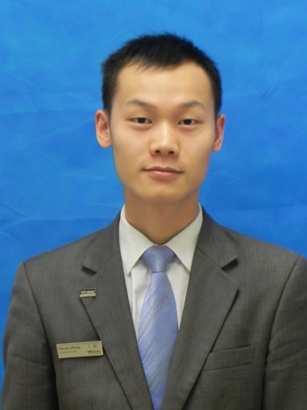
Outstanding Cares for Associate Award of April
四月杰出关爱员工奖
Steven Wang
王浪
ROOMS
房务部
Asst. Executive Housekeeper行政副管家

Slide 3
Outstanding Cares for Associate Award of April
四月杰出关爱员工奖
关爱是一片天空，给人无限的希望；关爱是一片森林，让人怀抱着梦想；关爱是一盏明亮的灯，照亮人们美好的未来。在我们HSKP-Floor部门，有很多关爱事例，现拾起记忆中的一朵浪花，与你们一起分享。
Love is a piece of the sky, want to give people unlimited; love is a forest, let people embrace the dream; love is a bright lamp, illuminate the people a better future. In our HSKP-Floor department, there are a lot of love stories, a spray is picked up in memory, and to share with you.
4月份，一个忙碌的月份，却也是一个见证爱的月份，在这个月我们客房部不仅要面临住房率饱满而员工人数紧缺的处境，而且要面临一年一度的LRA检查，LRA检查分数关系到整个酒店的形象及整个喜达屋集团旗下酒店的评比，而且还是一次暗访，
In April, a busy month, but it is also a lovely month, this month in our housekeeping department had to face not only the occupancy was 100% and the number of employees in short supply situation, but also face once a year LRA examination, LRA examination
score in relation to the rating and image of hotel.
Steven Wang
王浪
ROOMS
房务部
Asst. Executive Housekeeper行政副管家

Slide 4
Outstanding Cares for Associate Award of April
四月杰出关爱员工奖
这让我们客房部顿时感觉压力很大，但是我们的浪哥却对这些事早已做好了充分的前期安排工作，知道广交会期间每位服务员几乎没有休假时间.由于对服务员的关爱，在4月15号之前广交会将近，把21位楼层服务员的假都平均安排好，就连休会期间的也一起排好，争取他们每个人都有充足的时间休息，以饱满的精神状态迎接广交会的到来，但是看看排班表里王浪的那一栏，没有一天是休假的，他不是铁人，但他有铁人的精神，在忙碌之余，他第一个想到的还是他的员工。
It made our housekeeping department immediately felt pressure, but Steven Wang had make good preparation and arrangements before knowing that news. He knew that everyone would too busy to have holiday during the Canton Fair. Before April 15th ,Steven arranged the 21 floor attendants’ attendance roster in advanced to make sure everyone have enough time to rest and work with full mental state for the coming Canton fair. But Steven didn’t arrange his own rest. He had the spirit of iron man and he thought associates firstly.
还记得在4月11号那天晚上，平时7,8点浪哥都会出现在办公室了，但是今晚没有看到他，原来他是在楼层上面了，饭都没有下来吃，因为他正在为LRA的到来做准备.
Still remembered that on the night of April 11th, Steven
didn’t have dinner and still worked at the floor as the
preparation of LRA.
Steven Wang
王浪
ROOMS
房务部
Asst. Executive Housekeeper行政副管家

Slide 5
Outstanding Cares for Associate Award of April
四月杰出关爱员工奖
他没有和主管们说，当主管们吃过饭，写交接的时候，没有看到浪哥，打电话问浪哥，浪哥很轻松地说：“你们这几天辛苦了，快回去休息吧，准备明天的战斗哈。”但是主管们一个都没有回去，又接着上楼层帮浪哥的忙，只看到浪哥在LRA预留房间里亲自铺床，刷马桶，洗浴缸，吸尘，看到主管们，他只微微笑着说：我做得多一点，你们和服务员就多轻松一点。就这么一句话让主管们温暖全心，主管们也一起加班加点，一起忙到晚上12点半才回去。第二天来得最早的也是他，开早会时他不是一直强调着LRA注意事项，而是转移话题让服务员们以平常心对待，不慌张。
When the supervisors had finished the dinner, Steven didn’t tell the truth to them instead of letting them to go back home to
take a rest. But they didn’t go back and all chose to go upstairs and help Steven. Then they saw Steven making the bed, scrubbing the toilet, washing the bath and vacuuming. He smiled and said, I do more, you and the waiter can take it easy. His word make their heart warm, then they work together overtime till 00:30. The next day, he came back earliest and didn’t emphasize the LRA considerations at the morning meeting but change the subject, made attendants calm down and face troubles with common heart treat.
Steven Wang
王浪
ROOMS
房务部
Asst. Executive Housekeeper行政副管家

Slide 6
Outstanding Cares for Associate Award of April
四月杰出关爱员工奖
在广交会期间，住房已爆满，每位服务员的房量也远远超过平时，人在忙碌的时候往往心情不是很如意，为了给员工提供一个愉快的工作环境，营造良好的工作氛围，让员工既有快乐心情又能愉快工作，为此下足了功夫。比如浪哥每次上楼层，做起了听众，到服务员的工作间，和员工聊聊天，说说话，让他们有什么问题的就说说并安慰鼓励他们，让他们感觉公司对他们的照顾，让他们感觉到归属感有家的温暖。对员工进行情感管理，充分尊重和肯定员工；注重情感的交流与沟通，让员工始终相信酒店与他们是一家人；
Works are much more than usual so that many staff didn’t feel good. In order to provide a pleasant working and create a good working atmosphere environment for employees, he tried his best to let employees have a happy mood and work happy. Wave elder brother on each floor, for example, with the audience, to the waiter's workshop, and employees to talk, talk, let them have what problem about comfort and encourage them, make them feel company care to them, let them feel the sense of belonging with the warmth of home. Employees on emotional management, fully respect and affirmation employees; Pay attention to emotional communication, let employees believe that hotel and they are always a family;
Steven Wang
王浪
ROOMS
房务部
Asst. Executive Housekeeper行政副管家

Slide 7
Outstanding Cares for Associate Award of April
四月杰出关爱员工奖
而时常举办的员工活动，也在丰富员工业余生活的同时，发挥了增强凝聚力的效力。
And often hold staff activities, also in rich amateur life at the same time, the staff play an enhanced the effectiveness of the cohesion.
用心服务，让我们收获了顾客的认可；用心关爱，让酒店得到了员工的肯定。正如浪哥所说的“关爱员工”不仅是一句口号，更是实实在在的工作和行动，只有把各项工作细做到位，让员工从内心感受到公司对关心他们的关爱如家般温暖，才能增强企业的吸引力，凝聚力。
Serves attentively let us harvest the customer approval; heart care, let the hotel staff approval. As Steven said "care for associates" is not only a slogan, it is a real job and action, only to work attentively, let the staff
feel warm as family which strengthen enterprise's attractive and cohesive force.
Steven Wang
王浪
ROOMS
房务部
Asst. Executive Housekeeper行政副管家
Nominated by 提名者：
Sundy Wu吴云像, Student Trainee - FLOOR客房楼层实习生

Slide 8
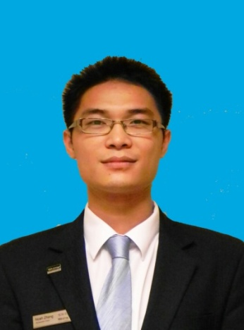
Outstanding Cares for Guest Award of April
四月杰出关爱客人奖
Noah Zheng
郑和丰
F&B
餐饮部
Team Leader – SeasonalTaste
知味西餐厅主管

Slide 9
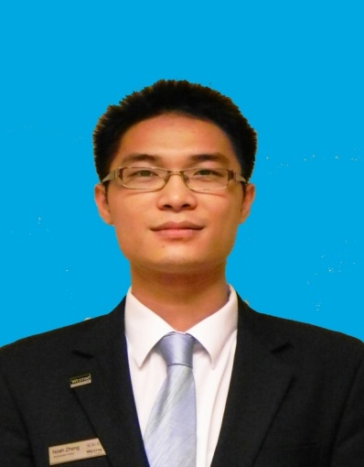
Outstanding Cares for Guest Award of April
四月杰出关爱客人奖
Noah是知味西餐厅客人的super star, 在西餐厅用餐的客人不管男女老少，中外宾客都能得到他细心细致的个性化服务，特别深得外国客人的喜爱。
Noah is the super star for guest in seasonal tastes, he always can offer personalized service for the guest, no matter children, the aged, ladies, gentleman, Chinese or foreign, they love Noah.
在113届春交会的时候，这一现象更为显现，由于他在餐厅工作的时间已经有一年半的时间了，经历了3次交易会，他所认识的客人数不胜数，甚至有的客人的特殊用餐喜好他都还记得一清二楚。
Noah has work here around one and a half year, he went through 3 canton fair, he knew lots of guest, he still remembered the special dinning requirement of some guests.
比如，这次有位叫Jose Carlos Ruiz的客人，在去年秋交会的时候，他们已经结下了深厚的情谊，当他再次在餐厅吃饭时，客人首先和Noah打了招呼，当时Noah还很纳闷为什么客人对他如此的热情，经过聊天他终于想起了
Mr Jose Carlos Ruiz, last year the guest came here for Canton Fair , his wife was pregnant, this year she gave birth a baby girl.
Noah Zheng
郑和丰
F&B
餐饮部
Team Leader – SeasonalTaste
知味西餐厅主管

Slide 10
Outstanding Cares for Guest Award of April
四月杰出关爱客人奖
客人的名字，并且还深刻的记得他的太太在去年怀孕今年生了一个可爱的宝宝，Mr. Jose还开心的拿出手机向Noah展示了他女儿的相片。
Mr Jose Carlos Ruiz show Noah his daughter’s photo. Noah always can treat guest as his friend.
诸如此类的事情举不胜举，我们深为Noah能待客人如朋友，如家人的敬业精神而感动。
Noah always can treat guest as his friend and family member, we are all moved with his spirit.
Noah Zheng
郑和丰
F&B
餐饮部
Team Leader – SeasonalTaste
知味西餐厅主管
Nominated by 提名者：
Yee Liu刘小易, Asst. Venue Manager - SeasonalTaste知味西餐厅副经理

Slide 11
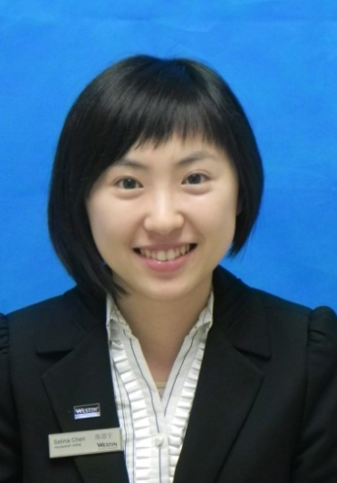
Outstanding Cares for Business Award of April
四月杰出关爱生意奖
Selina Chen
陈思宁
S&M
市场销售部
Asst. On-line Distribution Manager
助理网络分销经理

Slide 12
Outstanding Cares for Business Award of April
四月杰出关爱生意奖
数字营销其实是一个新兴的领域，发展极快，新鲜事物不断涌现。Selina为了做好工作，经常利用业余时间学习集团内部不断推出的新系统平台，并认真研习行业内的成功案例，展现了较强的学习能力。例如Guest Communication系统，作为电子邮件营销的平台，这个系统在国内的许多酒店并不受重视。但Selina在仔细研究国外姐妹酒店的成功案例后发觉，这个系统绝对可以为广交会威斯汀酒店带来较大的收益！他针对不同宾客、不同消费阶段、作出了不同的推广计划。其中针对第113届广交会设计和做出的AHBB推广，因宣传的内容描述详尽，夺人眼球，而且选取推广接受人群的定位精准，
Digital marketing is a newly developed field with rapid changes. In order to catch up with every opportunity, Selina often spends her spare time digging into new digital platforms and systems, studying successful cases, and she has demonstrated strong learning capability. Take the Guest Communication system for example. As an Email direct marketing system, many domestic properties usually don’t pay too much attention to it. But after Selina made her study and research in many successful cases from foreign sister properties, she suggested that this system would work for The Westin Pazhou! A detailed plan was carried out in order to target different segmentation during different consumption 、
circle. The AHBB offer she made for The 113 Canton Fair
was a real success. Detailed offer description, attractive
design plus accurate positioning.
Selina Chen
陈思宁
S&M
市场销售部
Asst. On-line Distribution Manager
助理网络分销经理

Slide 13
Outstanding Cares for Business Award of April
四月杰出关爱生意奖
截止至3月底已产生24个房晚的预订，收益可达14,462元美金。但是她并没有满足，目前还在积极推动upsell landing page的设置，相信以后可以为酒店带来更多利润。
This offer has generated 24 room nights and more than USD 14,462 dollars by the end of March within only a week. But she is still willing to go for the extra step. Now she is pushing the GC Upsell Landing Page setup. I believe she will bring more revenue to hotel soon.
另外，在餐饮的电子推广方面，Selina也作出了较多的努力。她建立了eMenus网站，为宴会举办者提供更个性化服务；建立了SPG Restaurants and Bars网站，为SPG会员提供丰富的酒店餐饮信息；完成了针对餐饮卡持卡人的eat drink and more网站的内容完善，扩大餐饮优惠在电子渠道的曝光和推广。
Besides, Selina also made massive efforts in F&B marketing. She set up the eMenus website, bringing more personal experience for meeting planners. She set up the SPG Restaurants and Bars website and offered various offers online for SPG members. She also optimized the Eat Drink & More website for EDM card holders and increased exposure for hotel promotions.
Selina Chen
陈思宁
S&M
市场销售部
Asst. On-line Distribution Manager
助理网络分销经理

Slide 14
Outstanding Cares for Business Award of April
四月杰出关爱生意奖
她秉着“多做一步”的精神，又主动整理了F&B Marketing Channels报告，积极与餐饮部沟通协商，在餐饮部同事的配合下，酒店首次开始系统化收集餐饮营销数据并进行分析，有效提高了酒店餐饮收入。
Then, she again took the extra step. She came up with a detailed F&B Marketing Channels report and shared it with F&B colleagues. With her initiative and support from F&B, for the first time that hotel venues started to collect useful marketing statistics for strategic analysis. And all these have significant impact on increasing F&B revenue.
除此之外，形象姣好的Selina还多次在业主的主办的宴会活动，酒店客户的大型宴会，市场部活动以及酒店内部晚会上担任主持人和司仪。作为工作繁忙的网络分销部门，做一次司仪主持，需要大量的时间去彩排，跟其他搭档练习。她不但占用自己工作之余的私人时间进行参与，而且还因为一流的口才及敏捷的反应，屡屡获得活动筹备方的青睐，以及给酒店管理层留下了深刻的印象。
Other than that, Selina has offered her help to be MC for many activities including owner’s dinner, clients’ thank you dinner, hotel annual party and many other marketing activities. To be well prepared for an event, she needs to spend much her spare time in practicing and
rehearsal. With all her endeavor, her eloquence and
agility has been highly appreciated by organizers and
left deep impression to hotel management team.
Selina Chen
陈思宁
S&M
市场销售部
Asst. On-line Distribution Manager
助理网络分销经理

Slide 15
Outstanding Cares for Business Award of April
四月杰出关爱生意奖
Selina作为助理网络经理，主要职责是配合市场传讯经理开展酒店宣传，形象推广，市场活动执行等工作，但她却一直将酒店的盈利任务放在首位，积极规划整合了日益多样化的数字渠道，为酒店争取了更多的宣传机会，也为酒店带来了更多的直接收入。
As Assistant Online Manager, Selina mainly assists MarCom Manager to promote hotel offers and executes marketing activities. During the process, she always keeps hotel business as the priority and positively integrates the more and more diverse digital channels to gain exposure for hotel and has brought much direct revenue to hotel.
Selina Chen
陈思宁
S&M
市场销售部
Asst. On-line Distribution Manager
助理网络分销经理
Nominated by 提名者：
Lion Li李洋, Marketing Communications Manager市场传讯经理

