Slide 1
Starwood Cares Recognition
Award for August 2013
喜达屋关爱奖励计划获奖名单 - 8月

Slide 2
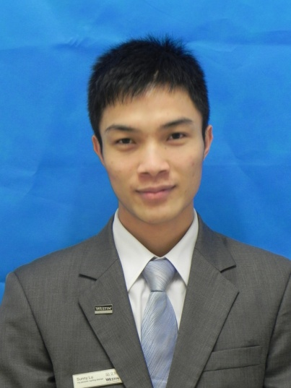
Outstanding Cares for Associate Award of August
八月杰出关爱员工奖
Sunny Lu
陆文辉
F&B
餐饮部
Team Leader - FiveZen5es中国元素餐厅主管

Slide 3
Outstanding Cares for Associate Award of August
八月杰出关爱员工奖
陆文辉Sunny是中餐厅的主管，即使有时看他是笑嘻嘻的，但是他做事比谁都认真，对同事也是很关心。在餐厅经常帮助同事并会细心，耐心的教导。
Sunny is the team leader of FiveZen5es. He works carefully in daily time although he laugh a lot. He do cares associates and always help others.
他之前是收银员，为了培训出一个胜任繁琐的收银工作的徒弟，他利用休息的时间给新员工孟有龙Paady传授收银工作的经验。由于刚刚接触收银工作和经验欠奉，Paady经常有做得不足的地方。有一天晚上做账的时候，Paady发现现金对不上报表的金额。他怎么找都找不到原因所在，情急之下就打电话给了正在休息的Sunny，接到电话之后，他很快的回到了酒店。
Sunny used to be a cashier. He wants to train a apprentice. He uses his resting time to teach Paady. For Paady’s weak experience of cashier, he always done less than place. When once paady find something wrong with the report forms at night. He can’t find the reason of it so that he call Sunny. Sunny come back to hotel immediately and started to check the report one by one.
Sunny Lu
陆文辉
F&B
餐饮部
Team Leader - FiveZen5es中国元素餐厅主管
Nominated by 提名者：
Sharon Xia夏小林, Captain - FiveZen5es中国元素餐厅领班

Slide 4
Outstanding Cares for Associate Award of August
八月杰出关爱员工奖
并开始查找现金对不上账的原因，一张张账单的开始检查。最后发现是收银结账的时候把现金的账单挂入了银联。所以导致现金挂入的账少了、银联挂入的账多了。当全部收银报表都做好的时候，已经快是晚上一点半了。他并没有责怪收银员，而是教导收银员下次要小心点，并在出错时该如何找出错误，在他的循循教导之下，Paady快速的适应了收银的工作，在之后的工作里陆文辉不断帮助Paady纠正他的错误。这样能让员工在鼓励的坏境下接受新的工作并能胜任他的新工作。
At last he find the reason at nearly 1.am. He didn’t blame the cashier but teach them how to deal with this kind of situation next time. Under his help, Paady do a better and better job and every associate is under a encouragement area.
一次接到领导的安排要整理红酒屋的时候，他在下班的时候领着一个收银员把整个红酒屋清理干净并排序的整整齐齐的。客人的存酒多又乱，有上千支客人存的红酒、洋酒、白酒，还有餐厅本身的快上万支红酒。
When he get the order to clear up the wine cellar, he clear it up after his duty with another cashier. There are many wine in the room, they need to mark every one of the wine and put it in order.
Sunny Lu
陆文辉
F&B
餐饮部
Team Leader - FiveZen5es中国元素餐厅主管

Slide 5
Outstanding Cares for Associate Award of August
八月杰出关爱员工奖
这些全部都要一一做好标签，放的整齐有序。当整理完的时候已经是快要下午吃饭的时候。他又顺便把仓库整理了一遍，在搬重物的时候还不小心闪了腰，到现在他的腰还时不时会痛。但是即使是这样，总是能看到他对员工亲切的笑脸。
After that he even clear up the room. But when he clearing the room he injure his waist. He always work with smile even with his waist ate.
对于新的同事，陆文辉总是能以包容和关心的态度去教导他们，能让他们感受到酒店的温暖。在我刚开始来的时候，陆文辉主动热情的告诉我哪些是熟客，他们享有哪些折扣，他们的兴趣爱好是什么，让我快速掌握整个餐厅的各种信息。他经常义务加班，下班后看到我们忙不过来都会帮助我们以后再走。虽然每天关心员工的都是小事，但是能一直坚持下来关心员工，就能成为最团结的团队
When he meet some new associates, he always teach them and care them friendly, which make them feel the love and warm of our hotel. When I was new here, Sunny told my who is the VIP and what discount did they get. It help me know everything about our hotel. He always stay to help us after his duty. Caring associate is a small thing, but if you insist it will become a great team.
Sunny Lu
陆文辉
F&B
餐饮部
Team Leader - FiveZen5es中国元素餐厅主管

Slide 6
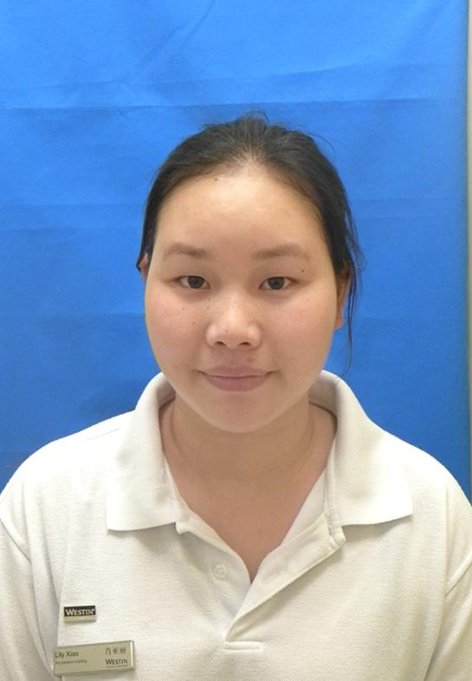
Outstanding Cares for Guest Award of August
八月杰出关爱客人奖
Lily Xiao
肖亚丽
ROOMS
房务部
Health Center Attendant
健身中心服务员

Slide 7
Outstanding Cares for Guest Award of August
八月杰出关爱客人奖
Lily Xiao自从2013年3月份加入健身中心以来工作已接近半年，作为健身中心的服务员她爱岗敬业，工作勤恳，多次受到客人好评。
Since Lily Xiao join us at March 2013, it has been nearly half year for her to work here. As the Attendant of health center, she love her job and get praise from guest.
Lily Xiao 能掌握客人的喜好，及时为他们送去贴心的服务，健身中心的资深会员刘小姐每次来都要中巾擦头发，Lily Xiao在前台接待的时候就做好准备，在客人进入更衣室时及时替客人准备毛巾;还有一位万先生喜欢在游泳完后喝一瓶水，吃个苹果，Lily Xiao也都周到的替客人准备，很多客人都有自己喜欢的固定钥匙，Lily Xiao在她值班的时候特别注意这些，尽量满足客人的要求并把这些信息告诉同事，让服务更上一层楼，让客人在健身中心得到放松，享受健身的乐趣！
Lily Xiao know the guest’s hobby and get a good preparing for the guest. Miss Liu is our VIP and every time she came she will use a towel. Lily Xiao always prepares it at the reception. Mr. Wan like to drink a bottle of water and an apple after his swimming. Lily Xiao will prepare it for the guest. Many guests like to have their own key, Lily Xiao will remember all these things when she is on duty. And she will tell this information to all her associates.
Lily xiao
肖亚丽
ROOMS
房务部
Health Center Attendant
健身中心服务员
Nominated by 提名者：
Ted Hu胡全军, Health Center Shift Leader健身中心主管

Slide 8
Outstanding Cares for Guest Award of August
八月杰出关爱客人奖
Lily Xiao在工作期间接触到两位来自香港的父女，他们在游泳后将客房的拖鞋弄湿了，Lily Xiao看到之后及时跟客人沟通要帮他们更换，以免客人穿着湿的拖鞋不舒服，事后客人很是感激，在入住的接下来几天都来健身中心，Lily Xiao也认真接待他们！对待所有客人如亲人一样。
When Lily Xiao work, she meet two HK guests. They make their slipper wet after swimming. Lily Xiao notice that and want to change another pairs for them. After that the guest feel very good and still going to the health center on the next few days. Lily Xiao services them as she services her family.
前段时间会员孙小姐在冲凉时不小心被花洒划伤了下巴，Lily Xiao得知后马上替客人准备消毒药水和创可贴，并叮嘱客人注意防水和饮食，并将此事告知GSM，及时处理事故并让客人满意。在客人再次来到健身中心时，Lily Xiao不忘问候客人并且让同事也注意这位客人。
A few days ago, Miss sun, our VIP, injure her jaw with the shower head. Lily Xiao knows that and prepare the disinfectant and band-aid for the guest. She tells it to GSM and make the guest satisfy. Every time when guest come out from the heath center, she will say hello to them.
Lily xiao
肖亚丽
ROOMS
房务部
Health Center Attendant
健身中心服务员

Slide 9
Outstanding Cares for Guest Award of August
八月杰出关爱客人奖
Lily Xiao总能想客人之所想，设身处地的服务客人，面对压力，她坚信优质的服务必定能创造宾至如归的感觉，所以我提议Lily Xiao为杰出关爱客人员工！
Lily Xiao can always think what the guest think, services them as she services her family. She believe that a better services will make the guest feel like at home. So I nominate her to be the Outstanding Care for Associates.
Lily xiao
肖亚丽
ROOMS
房务部
Health Center Attendant
健身中心服务员

Slide 10
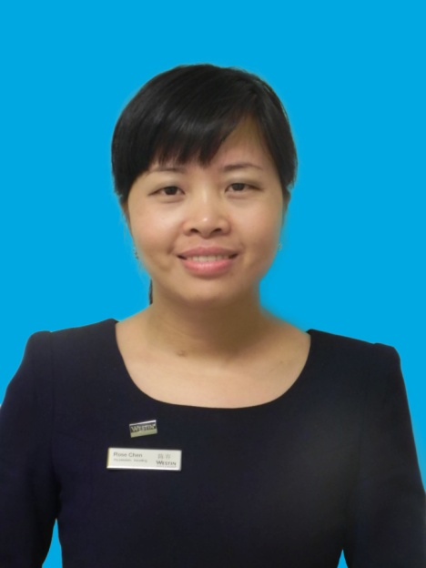
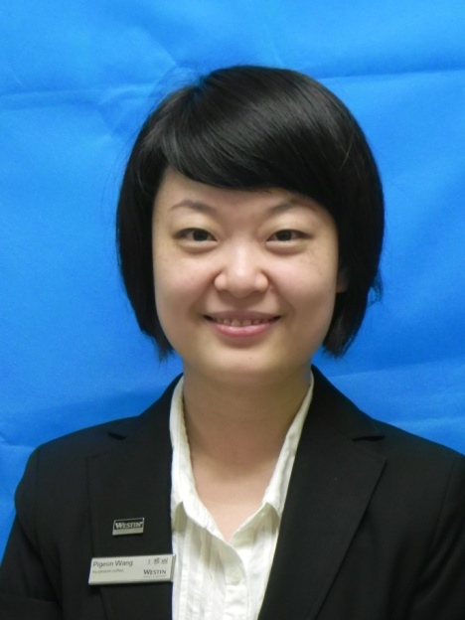
Outstanding Cares for Business Award of August
八月杰出关爱生意奖
Rose Chen
陈容
HR
人力资源部
Talent Development & Culture Manager
人才发展及企业文化经理
Pigeon Wang
王雅丽
HR
人力资源部
HR Manager
人力资源经理

Slide 11
Outstanding Cares for Business Award of August
八月杰出关爱生意奖
从服务利润链中可知，员工自身领导素质最后会带来客人忠诚度/长期经济效益，因此生意来源于员工。而我们人才发展与企业文化经理陈容Rose Chen和人力资源部经理王雅丽Pigeon Wang非常注重校企合作，帮助酒店找寻一批又一批的优秀实习生，充分展现关爱生意的力量。
From the service profit chain we can know, the leadership qualities of associates will eventually bring the guest loyalty and long-term economic benefits. So business comes from associates. Talent Development & Culture Manager Rose Chen and HR Manager Pigeon Wang are pay attention to the cooperation between colleges. To looking for excellent trainees shows the cares of business.
随着市场的不断发展，各酒店纷纷竞争着各大高校的人才资源，特别是实习生资源特别紧缺。在这种竞争激烈的人才环境中，要与高校形成稳定良好的合作关系并不简单，而两位经理积极地与多家高校有着
Because of the development of the market, The competition of looking for human resources from colleges and universities is harder and harder especially the trainee become less and less. In this competitive environment, It’s hard to form a stable relations between school and hotel.
Rose Chen
陈容
HR
人力资源部
Talent Development & Culture Manager
人才发展及企业文化经理
Pigeon Wang
王雅丽
HR
人力资源部
HR Manager
人力资源经理
Nominated by 提名者：
Amy Chen陈慧文, Director of Human Resources人力资源总监

Slide 12
Outstanding Cares for Business Award of August
八月杰出关爱生意奖
很好的沟通，通过参加高校的研讨会和帮助学校演讲职业指导课程，不仅增加酒店在学校里的知名程度和吸引力，而且使其成为了提供高质量人力资源的保证。为了增加我们酒店在学生当中的吸引力，Pigeon Wang到大学进行交流，使同学们更加了解我们广交会威斯汀酒店，Rose Chen与老师们进行各种专业研讨，使老师们更加了解到我们酒店的专业性。Pigeon Wang和Rose Chen正是酒店与学校沟通的重要桥梁，通过她们各自的优势，给予高校老师和同学们各种专业的意见，因此我们酒店总是争取到广交会前在最好的学校成为第一家招聘的酒店。
But both of them had a very good communication with several colleges and universities. For a better attractive name, they have a speech and a seminar in school. Pigeon Wang communicate with the university. It make that students know more about Westin Pazhou. Rose Chen had a seminar with school teacher. It makes teachers understand more about the professionalism of Westin Pazhou. Pigeon Wang and Rose Chen is the important bridge for hotel to communicate with schools. Through their sharing, it will give comments and profession advice to school teachers. So we always be the first recruitment of the hotel to school in
Canton fair interviewing.
Rose Chen
陈容
HR
人力资源部
Talent Development & Culture Manager
人才发展及企业文化经理
Pigeon Wang
王雅丽
HR
人力资源部
HR Manager
人力资源经理

Slide 13
Outstanding Cares for Business Award of August
八月杰出关爱生意奖
不仅与老师同学的积极沟通方面，而且两位经理还时刻关注到了学校实习生的感受，这都有利于我们的校企合作。每当实习生到酒店入职时，Rose Chen和Pigeon Wang热情的欢迎新员工的到来，让学生感受到酒店这个大家庭的温暖和慢慢地深入了解酒店。每当入职培训时他们都给予学生详细的介绍，带他们参观酒店，一步步地深入了解酒店。每当实习生工作一个月后都会和他们开一个反馈会议，让他们畅所欲言，解决他们的问题的同时也了解他们的需求。提高实习生的能力和创造力，进而提高酒店的整体质量。
Not only with positive communication from teachers and students, they cares the feelings of school trainee. This is good for the cooperation of school and hotel. Every time trainees enter our hotel, Pigeon Wang and Rose Chen give a warm welcome to them. Let the students feel the warmth of the hotel family and know more about the hotel. Whenever orientation hold , they will give students a detailed introduction and taking them to hotel tour. Whenever an trainee work a month, they will hold a feedback meeting with them. Letting them to have a speach and solving their problems as well as to understand their needs. Also it improve the ability and creativity of the trainee. It will improve the quality of the hotel.
Rose Chen
陈容
HR
人力资源部
Talent Development & Culture Manager
人才发展及企业文化经理
Pigeon Wang
王雅丽
HR
人力资源部
HR Manager
人力资源经理

Slide 14
Outstanding Cares for Business Award of August
八月杰出关爱生意奖
Rose Chen和Pigeon Wang在实习生实习的过程中全程地了解他们的心路历程，以及工作感受，给予他们适当的建议和帮助，获得了各校学生的好评，因此在长期实习生的合作中，最短的实习期为半年，这相比现在许多学校只提供三个月的实习生更有利于酒店的营运需求；在短期实习生的合作中，我们也获得了一致的好评并且成为许多高校长期稳定合作的酒店，在这广交会中获得最好的人才资源，有利于酒店的生意。
During the internship of trainees, they will know their feeling, giving them advice and help. So during the cooperation with long-term students, the shortest internship time is half year. It helps the hotel in operating requirements.
Rose Chen和Pigeon Wang不仅是酒店与学校沟通的桥梁，还为酒店的人力资源质量把关，使酒店中有稳定的实习生资源，充分展现关爱酒店生意的行为值得大家学习。
Rose Chen and Pigeon Wang is the bridge of school and hotel, checking for quality of the human resources. It makes the hotel have stable trainee resources. It shows the cares of business and it’s worth for learning.
Rose Chen
陈容
HR
人力资源部
Talent Development & Culture Manager
人才发展及企业文化经理
Pigeon Wang
王雅丽
HR
人力资源部
HR Manager
人力资源经理

