Slide 1
Starwood Cares Recognition
Award for February 2013
喜达屋关爱奖励计划获奖名单 - 2月

Slide 2
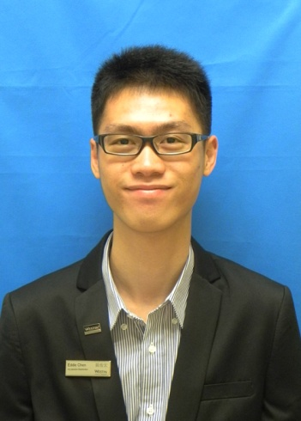
Outstanding Cares for Associate Award of February
二月杰出关爱员工奖
Eddie Chen
陈俊宏
HR
人力资源部
HR Coordinator
人力资源协调员

Slide 3
Outstanding Cares for Associate Award of February
二月杰出关爱员工奖
Eddie Chen是人力资源协调员，一个90后的大学毕业生。他的工作内容包括人事系统和档案的管理、考勤管理和社保业务等等。这是他的第一份正式工作，在工作中他总是展现出优秀的学习能力和严谨细致的工作态度。也正由于他的工作习惯和年龄，大家都认为他会是严谨周密胜于亲切耐心，但是我们不断听到来自不同部门的同事反馈Eddie总是能站在员工本人的角度替他人考虑，解决一些员工认为“传统的人事部”不会费心费力去替员工解决的“额外”的问题。例如在跟进怀孕女员工的保险和费用报销时，Eddie会不耐其烦地提醒女员工准备资料时要注意什么，而且社保部门拖延或推诿时Eddie也会尽力去争取。
Eddie Chen, HR coordinator, a graduating boy after 90s. He is responsible for the HR system & filling room management, attendance management, social insurance & housing fund, etc. This is his first job and he is always good at learning and has strict working attitude. Because of his working attitude and age, everyone think that he is more strict & thorough than sincere & patient. Continuously we receive the feedback from associate with each different department that Eddie is always stand by associates to solve the problem who though “traditional HR department” won’t handle with all their heart. Such as following up the women’s maternity insurance and expense claim. Eddie will remind associate patiently what need to be attention to prepare the material. Also Eddie will try his
best to strive for with the trouble social insurance bureau.
Eddie Chen
陈俊宏
HR
人力资源部
HR Coordinator
人力资源协调员

Slide 4
Outstanding Cares for Associate Award of February
二月杰出关爱员工奖
2013年2月4日上午，中厨厨师刘江波的妻子刘太太来到人力资源部咨询丈夫的医保卡被冻结的问题。原来刘师傅在前一天在家中做卫生时从梯子上摔下来，造成锁骨骨折，现在正在医院等待手术。Eddie了解后马上安排刘太太坐下休息，并给她倒了一杯温开水安慰她不要着急，社保问题一定可以解决的；然后Eddie马上把刘师傅的社保资料打印出来，并通过自己在工作中认识的社保部门的熟人问清了冻结的原因和解决方法，帮刘太太约好了直接可以找谁办理，这样就避免了到了现场还要咨询和排队。刘太太了解到Eddie特别为她做的安排后绷紧了整晚的神经终于松弛下来，心中感到又感激又温暖。
On February 4, 2013, Paul Liu’s wife Mrs Liu came to HR office to consult the problem which her husband's medical insurance card was frozen. When Paul Liu was cleaning at home, he fell off the ladder yesterday and was waiting for surgery . After knowing that, Eddie gave her a glass of water made her comfortable. Then Eddie printed the material about the social insurance and ask the professional people to find the reason. In order to avoid troublesome, Eddie help Mrs Liu which made her feel warm.
Eddie Chen
陈俊宏
HR
人力资源部
HR Coordinator
人力资源协调员

Slide 5
Outstanding Cares for Associate Award of February
二月杰出关爱员工奖
送走了刘太太后，Eddie第一时间把事情也告诉了我。我也马上报告了总经理和酒店经理，并与餐饮部总监和中厨行政总厨商量后，在下午开餐空当与主管部门员工事宜的副主厨劳师傅，传达来自管理层的关爱。刘师傅和太太都非常感动，刘太太更是拉着我说：“我真是第一次遇见这么关心员工的人事部，之前又忙又急了整晚都没什么感觉，但是在人事部的时候眼泪都忍不住了。我叫我老公将来一定要在公司好好工作。”
Eddie told this thing to me and I reported to GM and HM immediately. After discussed with Director of F&B and Chinese Executive Chef, We went to the hospital to care Paul Liu and convey the management's concern. Mrs Liu was grateful to us and could hardly repress her tears and told us his husband will work hard in our hotel after getting well.
Eddie Chen
陈俊宏
HR
人力资源部
HR Coordinator
人力资源协调员

Slide 6
Outstanding Cares for Associate Award of February
二月杰出关爱员工奖
事后我问Eddie为什么在解决了社保卡冻结的问题后还会想到第一时间报告一件不属于工伤的员工事务，Eddie说：感觉员工需要安慰和帮助，所以自然而然想到动用自己的私人关系来帮助，虽然自己工作范畴的问题已经解决，但还是觉得需要第一时间通知部门负责人，相信这样做更好。
正是这种在工作中精益求精GO EXTRA STEP的精神，帮助我们把来自管理层的关爱及时地传递给我们的员工，同时也让员工在点滴细节中感受到温暖的关爱；这也正是来自喜达屋之旅STARWOOD JOURNEY的三大精髓之一。秉持这种精神，相信Eddie将来会做得更好！
That is because the make perfection more perfect and go extra step spirit, to deliver the care from Excom and manager timely and make the associate feel warm with the details. That is also one spirit from our Starwood Journey. In accordance with this spirit, I believe Eddie will do it better!
Eddie Chen
陈俊宏
HR
人力资源部
HR Coordinator
人力资源协调员
Nominated by 提名者：
Amy Chen 陈慧文, Director of Human Resources 人力资源总监

Slide 7
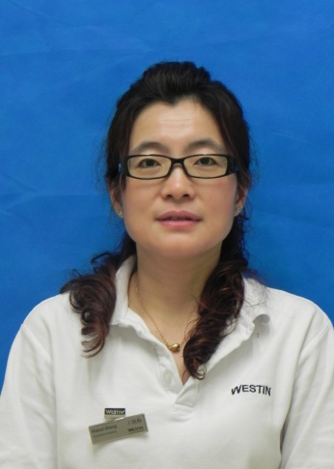
Outstanding Cares for Guest Award of February
二月杰出关爱客人奖
Mabel Wang
王晓梅
ROOMS
房务部
Laundry Operator
洗衣房服务员

Slide 8
Outstanding Cares for Guest Award of February
二月杰出关爱客人奖
王晓梅是洗衣房特别耀眼的一个亮点，漂亮、活泼、大方，我们将她称之洗衣房一枝花。从酒店开业至今，她一直从事客衣收发工作，在平凡的工作岗位上，她投入满腔的工作热情，兢兢业业，默默无闻地为酒店的洗衣工作倾注她的全部精力。
As a laundry operator, Mable Wang is a beautiful, outgoing and generous colleague. She has been engaged as a guests‘ clothing transceiver ,since the hotel opened . She worked enthusiastically, cautiously and poured all her energy into the job.
记得有一次，结束了一天的工作后，洗衣房一阵喧闹，“这件衣服的面料多好啊，扔了多可惜啊”“是啊，就是袖口破了一个洞”“但是很难补好的啊”原来这是工作人员在讨论刚从房屋中心收来的一件破衣服，“衣服看起来是新的，应该想办法补一下”晓梅若有所思。第二天，同事们来上班看到昨天破洞的衣服袖口上绣了一朵美丽的睡莲，睡莲的颜色搭上衣服整件衣服多了一大亮点，
One day, everyone in laundry were talking about the clothes which was nice, but had a hole in the sleeve. Though this clothes was new, it’s hard to mend a hole well for the guest. The next day, When people came to work, they saw the clothes with a hole turn to the clothes with beautiful water lily. It’s more beautiful than before.
Mabel Wang
王晓梅
ROOMS
房务部
Laundry Operator
洗衣房服务员

Slide 9
Outstanding Cares for Guest Award of February
二月杰出关爱客人奖
原来是下班后，晓梅没有马上回家，到前台去查了客人的资料，当得知客人是来自印度之后，又上网查之印度的国花是睡莲，二话没说就用自己的针线绝活帮客人在衣服袖口上绣了一朵睡莲，这样不仅能让客人体会到威斯汀酒店能给客人带来家的亲切，也能让客人体会到身在异国的温暖，当客人收到衣服看到破了的袖口上的睡莲的时候，一股亲切感油然而生，激动得下了眼泪，那行云流水般的细致，让客人倍感喜悦。
After finishing the work, Mabel didn’t go home immediately instead of knowing more the guest’s information of that clothes in the Front Desk. Not only did her knew that the guest came from India, but also their national flower was water lily. Without saying anything Mabel embroidered guest’s clothes with a water lily. This instinctive action let the guest feel warm as home in the strange country. When the guest received the clothes, he felt touched and exciting to tears.
Mabel Wang
王晓梅
ROOMS
房务部
Laundry Operator
洗衣房服务员

Slide 10
Outstanding Cares for Guest Award of February
二月杰出关爱客人奖
客人通过询问找到了晓梅，得知晓梅为了绣睡莲，整夜通宵，已经感冒休假了，客人表示很遗憾，第二天，穿着绣了睡莲衣服的客人在退房时，在前台留下了感谢信给晓梅，“非常感谢您的用心，我很喜欢你绣的睡莲，非常美丽，就像您的心灵一样，您们酒店让我这次旅途非常有意义，我下次来中国肯定还来您们酒店，我也会叫我的朋友来，听说你生病了，我很担心，这是我特别为您买的药，无论如何您都要服用。”晓梅没有想到自己的小小付出让客人这么的感动，心里很是高兴。晓梅的个性化服务给酒店的洗衣服务树立良好形象，给客下留下了非常深刻的印象。
In order to offer best service and care the guest, Mabel spent a whole night to prepare it. Before he checked out, the guest wanted to thank Mabel face to face, but she caught a cold and was on leave. When the guest checked out wearing this beautiful clothes, he left a thank you letter in Front Desk which written to Mabel: Thank you very much, I love your embroidered water lily, very beautiful. It’s meaningful for me to choose your hotel for my trip this time. I will certainly choose your hotel again next time. I heard you were sick, I'm worried about it. I have bought medicine for you and I hope it can help you. Mabel provided personal service to set up a good image of hotel and let the guest good impression.
Mabel Wang
王晓梅
ROOMS
房务部
Laundry Operator
洗衣房服务员

Slide 11
Outstanding Cares for Guest Award of February
二月杰出关爱客人奖
就是这么一个王晓梅，让我们感到温暖的力量、欣喜和满意。2012，她以最好工作态度和热情诠释着什么是友爱、舍得、坚持和优质服务。2013，她会以更饱满的热情，更高的工作标准，更加出色地完成各项工作任务。
Mabel Wang, let us feel the warm strength, happy and satisfaction. 2012, her best attitude at work show to us what is love, persistence and high quality service. 2013, she will be more enthusiastic, get higher work standards, complete outstanding work task.
Mabel Wang
王晓梅
ROOMS
房务部
Laundry Operator
洗衣房服务员
Nominated by 提名者：
David Xu 许英石, Director of Housekeeping & Spa客房及水疗美容中心总监

Slide 12
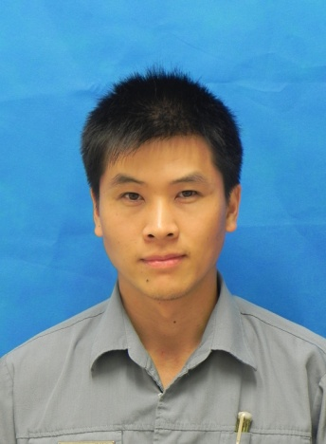
Outstanding Cares for Business Award of February
二月杰出关爱生意奖
Andy Lan
蓝兴平
ENG
工程部
M&E Leader
机械主管

Slide 13
Outstanding Cares for Business Award of February
二月杰出关爱生意奖
蓝兴平是酒店工程部机修主管，从2012年5月21日加入广交会威斯汀酒店以来，爱岗敬业、工作勤恳，把酒店当成家，经常很晚才下班，我19点20分路过机修工作间，仍见他在里面忙碌。
Andy Lan is working as M&E Leader since he joined the big family of The Westin Pazhou on May 21, 2012. He is always working hard for the hotel business development.
每当遇到厨房洗菜盘、卫生间洗手盘等排水管路堵塞时，总能见到蓝主管不怕脏不怕累，努力工作的身影。2012年12月21日，酒店负2F肉房至花房的一段排水管因天冷，排出的废油渣结块造成管路严重堵死，污水返冲回前端的洗菜间，臭水漫流到洗菜间门外，肉房和职厨地面污水溢流。蓝主管得知情况后，立即赶到现场，掀开排水管路中的沉沙池盖，不顾脏臭，趴下身子，顺着管道用力来回抽拉疏通器具，管道过于弯曲处，则用链条穿透后刮带管道内淤积油垢。经过多番努力，终于打通了堵塞的管道，蓝主管身上的衣服也被汗水和脏臭的污水湿透了。
Whenever the drain was blocked, we certainly saw Andy Lan worked hard without saying anything. Because the cold weather, the drain from butchery to greenhouse was blocked and made smelly. Andy Lan rushed to the scene immediately after knowing that and opened the sand basin cover, leaned over to look in the drain. He checked the machine and use
it to dredge. After many attempts Andy dredged the drain,
though his clothes was sodden with sweat and smelly.
Andy Lan
蓝兴平
ENG
工程部
M&E Leader
机械主管

Slide 14
Outstanding Cares for Business Award of February
二月杰出关爱生意奖
每年一度的集团卫生审计对于酒店是个严格的考验。广交会威斯汀酒店开业初期就曾发生卫生审计两次不合格，后来补考才有85.5的分数。审计中有一条要求是洗手星盆出水温度在开启后一分钟必须到达41℃，而酒店各区域共有26处洗手星盆的热水管道因原设计安装问题导致热水升温时间偏慢，存在不合格现象，严重影响到卫生审计评分和日常使用。如果要安装电热丝辅助加热装置，则每个点位至少也要花费1000元，全部改造完成就要26000元。2013年2月18日是集团来酒店审计的日子，面对短短不到一个月的时间，要完成其它的维修任务之外还要解决这个难题。
The annual hygiene audit is a strict test. The water temperature need reach 41 degree in one minute is one of the request of audit. Due to the original design and installation issues , the hot water heating slowly which seriously affect the score of audit. If we install heating wire auxiliary heating device, this transformation will totally take RMB26000. February 18, 2013, is the hygiene audit day. It will be a challenge for us to perform other maintenance tasks and solve this big problem with less than a month of time.
Andy Lan
蓝兴平
ENG
工程部
M&E Leader
机械主管

Slide 15
Outstanding Cares for Business Award of February
二月杰出关爱生意奖
蓝主管二话不说，根据现场管路状况，在不加辅助电热丝的情况下逐个点位进行改造。加班加点，日以继夜，终于赶在集团来酒店审计前圆满完成了管路改造任务，为酒店卫生审计达到93.7的历史最高分提供了有力的保障，并节约了26000元的改造费用。
According to the situation, Andy transformed 26 drains one by one without installing heating wire. He worked overtime. And finally he solved this problem successfully before audit. Andy cared the business of hotel and provided a strong guarantee to audit, and save the cost about RMB26000.
为了确保酒店供水系统的安全运行，蓝主管现在又愉快地接受了制作和安装生活水池水位探测器的任务。在各厨房维修之外，机修工作间和生活水池边总能看到他忙碌的身影。这就是我们的蓝主管，一个爱店如家，关心酒店生意，默默付出的好伙伴。
In order to ensure the safe of the water supply system, Andy accepted another task of produce and install the water detector. Andy Lan, our M&E Leader, cares about hotel’s business.
Andy Lan
蓝兴平
ENG
工程部
M&E Leader
机械主管
Nominated by 提名者：
Mike Shen 沈章文, Asst. Chief Engineer 副总工程师

