Slide 1
Starwood Cares Recognition
Award for July 2013
喜达屋关爱奖励计划获奖名单 - 7月

Slide 2
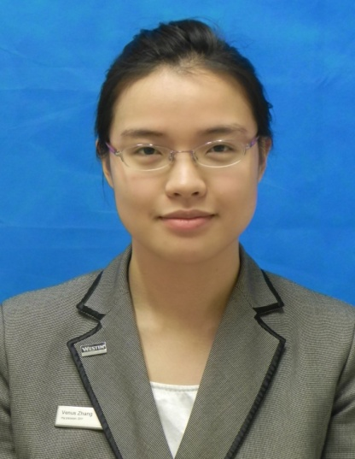
Outstanding Cares for Associate Award of July
七月杰出关爱员工奖
Venus Zhang
张艳
ROOMS
房务部
Service Express Agent
快捷服务中心(总机)服务员

Slide 3
Outstanding Cares for Associate Award of July
七月杰出关爱员工奖
Venus 自七月五号从预订部归来快捷服务中心后，部门每天的欢乐声又增多了一道风采。
Since Venus came back our department --service express from reservation on July.5. You can hear joking and laughing in our department every time.
因为预订部开始实施从周日休息， 发展到现在周六日都休息，他们的当日的订单都需要我们快捷服务中心去完成，因此，强大而专业的预定知识必须由预订部的专业人士指导之外，还需要每日的加强训练和强化。
Reservation department start to duty off on every Sunday from June and now both Saturday and Sunday duty off that means the same day booking need our service express staff to finish it. Therefore we need a professional staff from reservation department to teach us and need to do training everyday and get more extra practice.
Venus Zhang
张艳
ROOMS
房务部
Service Express Agent
快捷服务中心(总机)服务员
Nominated by 提名者：
Crystal He何锦君, Service Express Agent快捷服务中心(总机)服务员

Slide 4
Outstanding Cares for Associate Award of July
七月杰出关爱员工奖
因而每隔一天她都会利用中午交班后的时间来做预订部的小知识培训，以此增加我们对预订部的认识和做预订时我们要小心的事项，如针对网上旅行社像携程，艺龙等，国外旅行社像Agoda，华闽等，Wholesale以及销售部同事的订房预订，归纳整理出每个部分的细节和必须注意的地方。
Every two days she will make a small training after briefing in the afternoon which would sum up different detail parts and key points of making a reservation such as online travel agent like ctrip and elong, travel agent like Agoda and Huamin, wholesale and sales booking, in case to increase our ability to handle different booking.
自从有了这样的强化性培训，快捷服务中心的同事们都对预订产生了莫名的兴趣，每天待预订部下班后，一接到新的预订，大家都踊跃一试，遇到像挂房帐需要做routing的订单时，大家又会把笔记拿出来，小心翼翼地完成，若有不懂的，会互相指教，
Since we have a strongly training of make a reservation which make us have a big interesting in making a reservation. After reservation department staff off duty, all of us who received a fax of making a reservation would try her best to finish it. And when we
meet a reservation need to do routing each of us bring
own notes to finish it carefully.
Venus Zhang
张艳
ROOMS
房务部
Service Express Agent
快捷服务中心(总机)服务员

Slide 5
Outstanding Cares for Associate Award of July
七月杰出关爱员工奖
若实在不行，只能远程电话求助Venus，只要她能帮上的忙，她都会教我们怎样的操作。若超过她帮忙的范围，我们会选择找前台同事或值班经理帮忙。
If we meet difficult we can dial Venus’s mobile phone for help, she would taught us by telephone. If it over her knowledge we get help from Front desk staff or guest service manager.
因此，我强烈推荐Venus争当“杰出关爱员工” 奖，“三心”地教导每一位快捷服务中心员工，耐心地教导，有责任心地讲解，有爱心地传授知识给我们，如此一位好员工怎能不热烈推荐呢？
In a word I would recommend Venus get the Outstanding Care for Associates Award which this girl uses her heart to teach each staff from service express and would like to share reservation cases for us. Venus uses her patience to teach, has the sense of responsibility to explain, has the compassion to impart knowledge to us. Wow amazing staff! Strongly to recommend her to get to award.
Venus Zhang
张艳
ROOMS
房务部
Service Express Agent
快捷服务中心(总机)服务员

Slide 6
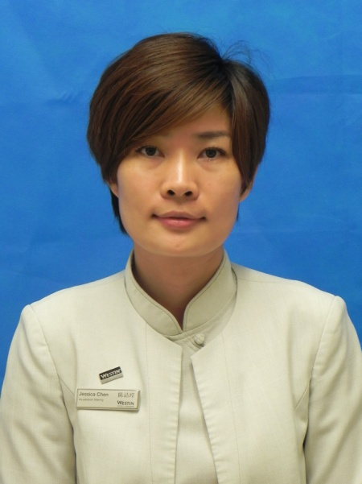
Outstanding Cares for Guest Award of July
七月杰出关爱客人奖
Lisa Li
李冬丽
ROOMS
房务部
Head Therapist
首席理疗师

Slide 7
Outstanding Cares for Guest Award of July
七月杰出关爱客人奖
Lisa是水疗中心的首席理疗师。在平时的工作中除了要做好自己对客服务的分内事，还会负责理疗师的培训指导并向团队的服务和收益多次提供良好的建议和意见。可谓以身作则，事无巨细。同时，Lisa一直以来以关心客人需求为最大闪光点，备受客人好评。
Lisa is the chief therapist of Heavenly SPA .In the usually ,Lisa will do her routine customer service job, on the other hand, she needs to be responsible for therapist training guide and provide good suggestions and opinions to the service and benefit team. She is always being a good example for caring guests and highly commended by our guests.
这是七月份的一个普通的工作日，正常理疗师上班的时间是下午三点钟。因为接到客人钱先生十点钟的预订，Lisa九点半钟早早地来到水疗中心，为客人的到来做着充足的准备。钱先生是我们的会员，但是Lisa也没有掉以轻心，从在前台迎接客人一直到最后送走客人，
One day of July, The duty time of Therapist is 15:00 pm. Lisa came to Spa earlier to prepare the treatment room for the guest at 9:00,The guest made the appointment for the treatment at 10:00. Mr. Qian who is a member of our spa, Lisa was careful to do every details for the guest.
Lisa Li
李冬丽
ROOMS
房务部
Head Therapist
首席理疗师
Nominated by 提名者：
Sheri Xia夏媛, Asst. SPA Manager 水疗中心副经理

Slide 8
Outstanding Cares for Guest Award of July
七月杰出关爱客人奖
一丝不苟地按照我们的服务标准一一进行着。原本钱先生只预订了一个60分钟的身体按摩和45分钟的身体磨砂护理。但感觉Lisa的手法非常好，人也特别放松。于是再加多1个小时的按摩和一个小时的面部护理。一共是4个小时！这对个人的体力是一个非常大的挑战，而且已经到了午饭时间，同事们也为Lisa打包了中饭上来，可是Lisa考虑到客人所希望得到的服务是连贯且一气呵成， Lisa没有向客人要求中间休息一下。就这样，客人体验到一个非常连贯而优质的服务，而此时已经是下午2点半了。同时，也为我们带来将近3000元的收益。
From the guest arriving to the end of his treatment, she followed the process operation, because of the high quality service, Mr.Qian added for one more hour body massage and one more hour facial basis on his original treatment, totally was four hours. In order to ensure the treatment accomplished with high quality, Lisa did not eat lunch until the treatment finished at 2:30 pm, at the same time ,Lisa let our spa income CNY3000.
在送走钱先生的时候，他很满意地对我们说，其实他是长居在北京的商务人士，也会经常出差来到广州。
When we had farewell with Mr.Qian, he was very satisfied and told us his Westin complex, he is a business man who are living in
Beijing.
Lisa Li
李冬丽
ROOMS
房务部
Head Therapist
首席理疗师

Slide 9
Outstanding Cares for Guest Award of July
七月杰出关爱客人奖
广州的所有国际5星级酒店，他都有光临过，包括在北京的时候他也住过威斯汀酒店。但他独独选择并且十分中意广交会威斯汀酒店，就是因为这里的水疗服务确实很不一样。我们的员工很能感同身受，能够真正做到尽心尽力地提供给客人最美好的体验。因为总是要出差所以喜欢来到水疗做一些放松的项目而且理疗时间时间都比较长，大部分的理疗师也到了三个钟头的时候已经体力不支，力度有所变化。而这次，Lisa给他的体验是由始至终感受都非常好，没有任何懈怠。并且还向他介绍了平日如何用相关的动作和食物来保健自己的颈椎，避免过度劳损带来的伤害。就是这些原因，这样亲切而体贴的服务，即便不是本地人，他也会选择成为我们的会员。
He has came to Guangzhou of many times, and he has visited all the international five star hotel in Guangzhou, including the Westin Beijing, but he is still very like and had choose the Westin Pazhou, because of the High quality spa service. Many therapists can only provide 3 hours massage and end with a little bit tired, therefore, he felt as not good as the beginning. However, Lisa left him a very good expression. We served him well not only every time, even every minute he loved and enjoyed so much. Lisa also introduced some food and yoga poses to protect the back and neck. That is why he wants to join to be our spa membership; even he is not a local person.
Lisa Li
李冬丽
ROOMS
房务部
Head Therapist
首席理疗师

Slide 10
Outstanding Cares for Guest Award of July
七月杰出关爱客人奖
Lisa就是这样尽心尽力地为每一位客人提供着高质量的服务。这天是一位来自香港的白金卡客人陈先生，订了一个客房包价的促销优惠。晚上十点如约来到了水疗中心，这回又是Lisa帮忙接待。整个过程的体验，陈先生非常满意。当即就跟我们说，之前就很喜欢威斯汀，一直也是住天河那一边。这边主要是晚上没有什么逛街的地方，但是这次我的水疗体验非常好，尤其是Lisa在过程中与擅长聊天的陈先生沟通了很多养生之道，比方说陈先生经常会失眠，Lisa就介绍了用相关促进安定和睡眠的精油来香薰，其次就是介绍了一些巩固神经放松的穴位自己可以多多按摩，受益匪浅，以后肯定常常来了。明天还想加多一个套餐，但是第二天中午12点就得退房赶回香港，不知道你们能不能安排到呢。
Lisa is committed to provide every guest of a high quality of service. This day, have a guest name is Mr Chen who is coming from Hong Kong, one P member in our hotel, he booked a room package including our spa of 60 minutes signature massage. So he is arrived in spa at 10:00 pm, Lisa welcomed the guest n the spa front desk, Mr.Chen was very satisfaction with whole procedure ,said to us he likes The Westin Resort, always living in The Westin Guangzhou, but he will consider staying in our Westin Pazhou next time ,because this time he had a fantastic experience in our spa. And he learned a lot from Lisa, she told him about the essential oil is good for sleep and with some massage on the accupoint.
“Can I request another treatment tomorrow. But I will
back HK, So I need check out at 12:00”Mr.Chen said, “
Lisa Li
李冬丽
ROOMS
房务部
Head Therapist
首席理疗师

Slide 11
Outstanding Cares for Guest Award of July
七月杰出关爱客人奖
Lisa这时毫无犹豫回答，没问题的，您的光顾就是我们无比的荣幸，随时都欢迎您的到来。就这样夜晚凌晨一点下班的Lisa，第二天9点又赶回来加班只为陈先生提供了另一次美好的水疗体验。陈先生在退房的时候跟我们的前台同事说，Lisa真是太棒了，不仅仅是她的手法和专业度，更重要的是，她会担当起自己的工作职责并且能与客人有着非常平实亲切的交流。在这里，做按摩的项目，不仅仅身体得到放松，在体验中彼此的交谈和沟通让他感觉好像来到一个温暖的大家庭。
Of course, that is our honor can service you again ,welcome you coming of every time” Lisa answered, That day Lisa was off work at 01:00 ,then, next day morning at 9 o’clock to provide a wonderful experience for Mr.Chen, When Mr.Chen left our spa and told our spa colleague. He really loved here, not only for our excellent service, but also we communicate with him like we are the family. He is not longer a guest in Guangzhou.
Lisa Li
李冬丽
ROOMS
房务部
Head Therapist
首席理疗师

Slide 12
Outstanding Cares for Guest Award of July
七月杰出关爱客人奖
Lisa就是一位关心客人的优秀代表。一直以来，Lisa工作态度一丝不苟，勤勤恳恳，凡是以客人和生意为先。多次获得客人的赞赏，水疗中心的客人反馈意见簿上，有很多都是对Lisa的嘉奖。平日也热心帮助同事，有时候，同事临时有事，班次换不过来，Lisa也总是主动站出来帮忙分担。参与团队各项工作任务的分派和完成，获得了团队的一致认同。从开业筹备到如今酒店即将迎来两周岁，Lisa也从一名理疗师成为现在的首席理疗师，与酒店一起成长着。
Lisa is a good representative of a caring guest. Lisa is meticulous and work attitude, Sometimes , Colleague ask for leave ,the shift staff is not enough ,Lisa would like to help ,she has received our spa team recognition of the job performance .from the opening until now ,our hotel is 2years older, Lisa also from a therapist to be a therapist supervisor ,grow up with our hotel.
Lisa Li
李冬丽
ROOMS
房务部
Head Therapist
首席理疗师

Slide 13
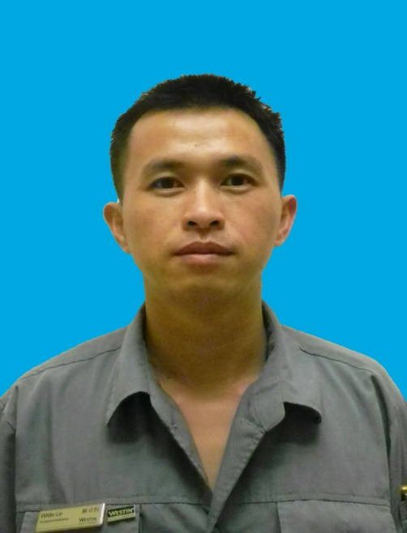
Outstanding Cares for Business Award of July
七月杰出关爱生意奖
White Lin
林卓恒
Engineering
工程部
Shift Leader – ENG
工程主管

Slide 14
Outstanding Cares for Business Award of July
七月杰出关爱生意奖
林卓恒是酒店工程部强电主管，从2012年3月19日加入广交会威斯汀酒店以来，爱岗敬业、工作勤恳且高效。
White Lin is the supervisor of ENG. He passionate in his job and work efficiently since his start at 19th March 2012.
最近不时会接到客人投诉晚上睡到半夜灯会自己亮，检查发现，中间继电器到了一定年限，会产生金属疲劳，造成会不时自动发信号出去，产生半夜亮灯的情况。林卓恒研究了很久，尝试取消中间继电器；在改造的工程中，他还发现我们的插卡取电开关成本比较高，达到每个960元，通过实验和摸索，林卓恒现在可以用取消中间继电器又将插卡取电开关成本降到10元以下，改造以后，不仅可以降低客人的投诉率，而且
Recently many guests complained that the light will turn on automatically at mid-night. After the checking, he found that the electric relay has reached its limit time which will cause metal fatigue. And it will send out signal automatically. After White Lin’s working in it, he decided to cancel the electric relay. During the period, he found that the switch will cause high to RMB960. After working in it, he discovered that a way to reduce the cost. to
deal with the left room.
White Lin
林卓恒
Engineering
工程部
Shift Leader – ENG
工程主管
Nominated by 提名者：
Mike Shen沈章文, Asst. Chief Engineer副总工程师

Slide 15
Outstanding Cares for Business Award of July
七月杰出关爱生意奖
能够降低维修成本。目前已改造好6间客房试运行，这几个房间暂时没有接到客人的投诉，他现在准备进行全面改造。
Also it decrease the compliant rate and the cost. From now on there are
6 rooms trying to run this system and waiting to deal with the left room.
酒店客房所采用的照明智能控制系统极不稳定，经常出现房间突然没电或灯光不受控的现象。可以想像得到，要是客人突然所住的房间没电并且黑漆漆一片、也没有空调，因故障未排除而不能及时送电，那客人的感受和心情是何等的糟糕，我们酒店的GEI指数和效益也会随之下降。为了及时排除房间所发生的故障，林主管总是设法向安装单位学习排除问题的办法以及软件参数的设置，通过不懈的努力他已成为一名行家里手。每当客房灯光控制系统出现故障时，他总是及时地解决问题。
Now the intelligent lighting system is very unstable so that the lights always broke down or be out of control. Imaging that, when the guests come back to his room and find it dark and not air-conditioner working, how will he feel? Terrible! So it would bring us the low GEI score. Thanks to White’s hard work via learning from the manufacturers and his own experiment, he now becomes a expert to solve almost all the lighting failure.
White Lin
林卓恒
Engineering
工程部
Shift Leader – ENG
工程主管

Slide 16
Outstanding Cares for Business Award of July
七月杰出关爱生意奖
记得在春交会期间，有一个犹太人团体入住酒店，由于4月26日（星斯五）是犹太人的节日--安息日，客人需要从入住的23楼沿走火楼梯步行至1楼，要求将所有的楼梯灯从原先的感应控制改为常亮状态，并要保证每一盏灯是亮的。另外同时还有一个接待团要求在5F，16F，31F避难层加装消防走火指示灯牌，每个施工点位都要重新布线走管固定。面对如此迫切的任务和所申购的材料因某些环节迟迟不能到位，他翻箱倒柜通过现有资源、加班加点，并取得销售和采购部同事的大力支持，终于赶在客人要求的时间前圆满完成了任务。
During the Spring Canton Fair, one Jewish group comes and stays in our hotel. Due to Friday is their Sabbath, the guests require that they need walk to the ground floor from 23rd floor, and all the inducting lights should be on all the time. At the same time, another group ask us to add the Fire-escaping Guidance Sighs on 5th, 16th, 31st floors, with all the construction point being fixed by rewiring. Facing such an urgent task and hard to find the materials, White rummaged through to find some useful makings and finished all the things after working hours. With the support of S&M and Purchasing Dept., he gave our guests a satisfactory answer.
White Lin
林卓恒
Engineering
工程部
Shift Leader – ENG
工程主管

Slide 17
Outstanding Cares for Business Award of July
七月杰出关爱生意奖
林主管在圆满完成强电维修工作之外，还主动参与工程部各专业系统的维修，发挥他高效而敬业的精神，完成了酒店门外道路减速带等多项维修工作，为店生意尽心尽力。
Besides conducting the electrical maintenance, White also takes part in the repairing other professional systems. He is willing to learn and a fast learner. With him, we save a lot of money and energy, and we also love to work with him.
White Lin
林卓恒
Engineering
工程部
Shift Leader – ENG
工程主管

