Slide 1
Starwood Cares Recognition
Award for Jun 2013
喜达屋关爱奖励计划获奖名单 - 6月

Slide 2
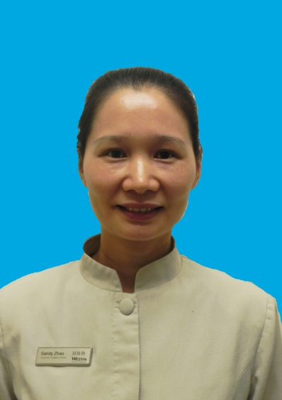
Outstanding Cares for Associate Award of Jun
六月杰出关爱员工奖
Sandy Zhao
赵妹焕
ROOMS
房务部
Room Attendant
客房服务员

Slide 3
Outstanding Cares for Associate Award of Jun
六月杰出关爱员工奖
赵妹焕是我们酒店老员工了，自从加入到我们客房部以来，她总是默默的奋斗在岗位上，从普通服务员到资深服务员，她耐心细致，兢兢业业，任劳任怨，不计较个人得失，不要求回报，对待同事就像对待自己的家人一样，她总是在我们最需要的时候站出来，给予我们温暖的支撑。
Sandy Zhao is one of senior associates in our hotel. She worked with patient and painstaking and kept her hard working without asking for any repayment.
因为楼层主管空缺，新的又未能及时到岗，忙起来的时候，对于主管来说，工作量会突然增多，这时候，作为资深服务员的她站了出来，主动分担起主管的这一份工作。三个多月以来，她不断的学习着主管的工作，刚开始的时候，总是查房查到忘了吃饭，但是不论她多忙多累，她总是不会忘记提醒自己的同事吃饭或者是帮助自己的同事。
As the occupancy of floor supervisor, the workload would raise to supervisor. Sandy Zhao shared the supervisor work actively. In this three months, Although she always didn’t forget to eat and felt tired and busy, she never forget to take care her colleges.
六月份的月末，我们酒店迎来了一批都是一家人出来旅行的客人，其本上每一个房间都会有小孩子，客人们退房之后，房间并不好收拾。
In Jun，our hotel had a group of guests traveled with family.
Sandy Zhao
赵妹焕
ROOMS
房务部
Room Attendant
客房服务员

Slide 4
Outstanding Cares for Associate Award of Jun
六月杰出关爱员工奖
而她所管辖的那些楼层区域，有一位新入职不久的女孩子，恰巧大退房的那一天，可能是因为不太适应新环境，导致身体不适加上房难做，一直都了下午五点钟了，还有一半的房量没完成。这时候，赵妹焕就把有预定的房间先检查了，然后二话不说，撩起袖子帮那位新同事一起做房。尽管有了她的帮忙，但是六间房的房量，也并不是一下子就能完成的，差不多七点钟准备没饭的时候，她还提醒那个女孩子下去吃饭，但是为了能早点做完房，她却没有走的意思，到最后，她俩谁都没有下来吃饭。一直到最后，房做完了，那位女孩子可以休息了，她还继续查未查完的房才回到办公室写交班，下班。
And a girl who was new didn’t adapt to the new environment and couldn’t finish the work. She only finished half of her task at 17:00. When Sandy knew this, she helped the girl to complete the work without any words.
很多时候，让人感觉到温暖的，并不是你做了什么了不起的大事，而是从工作里面渗透到生活的这些细微的感动。赵妹焕就是这样子，尽管她现在做的是主管做的工作，承担的责任也比我们的重，但是无论多忙，他对同事的关心，依然如此，细到极致，暖到永久，总是在我们需要的时候，站出来。
If you want to let a person feel warm, you don’t need to do a great thing. You just do it with tiny moving thing. Though it was busy,
Sandy cared us in a warm way.
Sandy Zhao
赵妹焕
ROOMS
房务部
Room Attendant
客房服务员
Nominated by 提名者：
Ivy Huang黄嘉齐, Room Attendant客房服务员

Slide 5
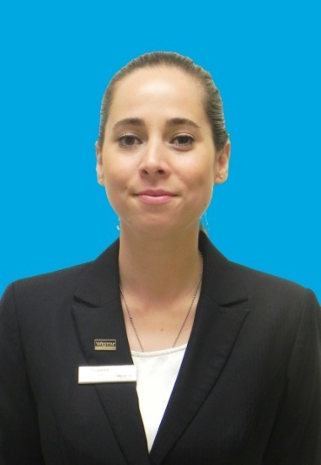
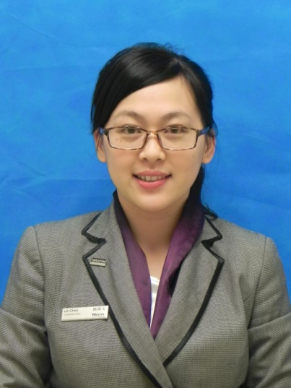
Outstanding Cares for Guest Award of Jun
六月杰出关爱客人奖
Liza Baqueiro
F&B
餐饮部
F&B Management Trainee
餐饮管理培训生
Lili Chen
陈丽文
ROOMS
房务部
SPA Receptionist
水疗中心接待员

Slide 6
Outstanding Cares for Guest Award of Jun
六月杰出关爱客人奖
从6月9日起，酒店接待了VIP客人Mr. Nygard 及其随从合共11人，（一共5个房间，合共20个房晚），根据以往的经验，Mr. Nygard和他的团队要求受到特别的关注，因为他们全天不断会有各种特殊要求，但同时，他们为酒店带来很多收益。因此，来自餐饮部的Liza和来自房务部的Lily被安排跟进这个团队，并在这个团地入住期间提供24小时的个性化服务，因此Liza和Lily都搬进酒店，因为一旦Mr.Nygard团队有任何要求都会直接打Liza或Lily的私人手机。
From June 9th, our hotel received a high profile VIP, Mr. Nygard, and his entourage for 4 days (a group of 11 people, in 5 rooms). From past experience with this guest we knew that he and his group required special attention, as they have a lot of demands around the clock. But they also bring a great deal of revenue to the hotel. Therefore, 2 members of our team were assigned to help follow up this group and offer 24-hour personalized service, assisting with all their requests throughout their stay. These associates were Lily from Room and Liza form F&B. The girls moved into the hotel for the period, and were the sole point of contact for all the groups needs via their personal mobiles.
当接到通知后，她们立即联系销售负责人Tinson和客房部同事并请教客人之前在我酒店入住时有何习惯和应该注意的地方。
将所有的信息一一熟记并期待着客人的光临。
They remembered all the guests’ preference before the
guests came.
Liza Baqueiro
F&B
餐饮部
F&B Management Trainee
餐饮管理培训生
Lili Chen
陈丽文
ROOMS
房务部
SPA Receptionist
水疗中心接待员

Slide 7
Outstanding Cares for Guest Award of Jun
六月杰出关爱客人奖
前一天还上班直到凌晨1点多的Lily第二天7点就按时到了酒店，首先来到安排好的客房，再次确认窗帘是否正如客人喜欢的那样是打开的，电视机是否一打开就停留在客人中意的频道。9点半客人们到了，Lily在大堂以最好的姿态和最美的笑容迎接了他们并致以最诚挚的问候，同时向他们介绍自己便是他们在这里的贴身管家，如果有任何的需要都可以随时联系她。就是这样，帮客人准备电梯，为客人联系电瓶车.同时，Liza每天早上4点钟起床帮客人点送餐，她帮他们把晚餐安排在各个餐厅，并在席间提供服务，而她还需要根据Mr Nygard严格的饮食规定，每天提供5次的客房送餐
Lily prepared well before Mr.Nvgard arrived. When the guests came, Lily showed her warm welcome and smile to them. To give you an idea of what sort of service they provided, aside from regular hotel service, Lily escorted the group daily back and forth to the Exhibition center; Meanwhile, Liza woke up every morning at 4am to answer room service requests from the group, she arranged dinner in all 3 venues for the group and supported during service, and she made sure Mr. Nygard followed his strict diet everyday providing him with 5 meals a day though IRD.
Liza Baqueiro
F&B
餐饮部
F&B Management Trainee
餐饮管理培训生
Lili Chen
陈丽文
ROOMS
房务部
SPA Receptionist
水疗中心接待员

Slide 8
Outstanding Cares for Guest Award of Jun
六月杰出关爱客人奖
11号Nygard先生的助理Marible需要购买晚礼服去参加晚宴，Lily考虑到Marible可能对当地的情况不是特别熟悉，因而主动提出带着她一起去买。他们在礼服店和百货区逛了4、5个小时但都没选到合适的。这时，lily打电话问朋友，问同事，上网搜索，希望能够找到做晚礼服比较专业的店面。终于，被她找到一家知名品牌的晚礼服专卖店，并且Marible在这家店挑选到了非常满意的衣服。Marible非常之感谢Lily，并称赞她很有耐心，从不说累。
Mr. Nygard and his assistant Marible needed to buy a evening dressing for a dinner party at June 11st. Lily consider that Marible may not familiar with local situation. So she go shopping with her initiatively. After four to five hours shopping in the clothes store and shopping mall, they didn’t fine a suitable one. In this case, Lily did everything she can (calling her friends, asking her colleagues, searching on the internet) to help Marible to fine a more professional store. Finally she found a professional store which sell evening dressing. Also Marible had found a satisfy one. Marible thank her patience.
同行的Ms.Otten看起来有些不太舒服，询问之后才知道客人有点皮肤过敏的现象而且有贫血的症状。在征求客人的意见和同意过后，
When some of the group members were not feeling well, they requested some medicine that we did not have.
Liza Baqueiro
F&B
餐饮部
F&B Management Trainee
餐饮管理培训生
Lili Chen
陈丽文
ROOMS
房务部
SPA Receptionist
水疗中心接待员

Slide 9
Outstanding Cares for Guest Award of Jun
六月杰出关爱客人奖
Lily和Liza帮客人购买了补铁的营养液和治疗过敏的息斯敏。在服用药品过后，Ms.Otten很感激地表达了她由衷的谢意，这种体贴和关怀让她觉得就像她的家人一样。并在之后，向其他客人推荐的水疗中心，希望他们可以获得身心的放松。在Lily的推荐下，Ms.Otten和她的随行人员来到SPA，非常满意地体验了天梦水疗。并且觉得，身体情况好转了许多。
and so Lily and Liza went out at 10pm to the chemist to find them which make them feel warm. And recommended them to heavenly spa.
在这短短的四天时间，无微不至的Lily和Liza让Mr.Nygard 和他同行的人员都感觉到酒店给他们的关怀和支持。对于酒店提供的个性化服务并满足他们各种的需求给予非常高的评价，Liza和Lily经过4天以后每天都超过15小时的工作，她们送别了Mr. Nygard的团队。
At this short four days, Mr. Nygard and his partners feel the concerning and supporting of our hotel by Lily and Liza’s meticulously. They gave a really high appraise of hotel’s individuate service. It satisfy their demanding. After this four day, which Liza and Lily works over 15hours per day, they say goodbye to Mr. Nygard and his team.
Liza Baqueiro
F&B
餐饮部
F&B Management Trainee
餐饮管理培训生
Lili Chen
陈丽文
ROOMS
房务部
SPA Receptionist
水疗中心接待员
Nominated by 提名者：
Michael Neal 聂卫欧, Asst. Director of F&B餐饮部副总监
Sheri Xia夏媛 , Asst. SPA Manager水疗中心副经理

Slide 10
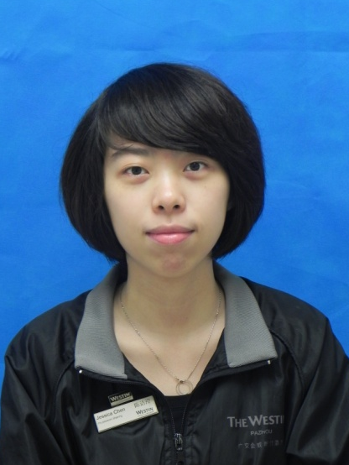
Outstanding Cares for Business Award of Jun
六月杰出关爱生意奖
Jane Lin
林文静
Finance
财务部
General Cashier
总出纳

Slide 11
Outstanding Cares for Business Award of Jun
六月杰出关爱生意奖
6月的广州，盛夏的开始，但对于财务部的员工Jane来说，一点感觉也没有，因为这大半个月来，她总是早出晚归，丝毫没有因为炎热的天气而减慢工作的脚步。
In June, the hot summer was coming, but Jane didn’t slow down and kept working hard.
2013年6月，原本在财务部实习到寒假的实习生由于学业原因提早结束了实习；而为期一年的郑州实习生也在6月10日结束了实习，而新的实习生需要到7月初才入职。面对财务部缺少两名员工的情况，如何合理分工，让财务部工作正常开展，成了当务之急。
Two of Finance trainees need to finish their internship as the academic reasons. And new trainee will come in July. In the face of lacking of two employees, how to reasonable division of labor, let the finance department carried out normally, became a priority thing.
两名实习生是负责应收和总出纳的工作，而Jane 以前就是负责总出纳的工作，现在负责处理应收工作，对总出纳和应收两个岗位都非常熟悉，眼看离新的实习生还半个月的时间，再去培训其他的员工也不太适合，没
Two trainees was responsible for general cashier which
Jane used to be. So Jane was the most familiar with this
part.
Jane Lin
林文静
Finance
财务部
General Cashier
总出纳

Slide 12
Outstanding Cares for Business Award of Jun
六月杰出关爱生意奖
有比她更合适去兼顾AR和GC的工作，可是酒店80%的收入都是通过信用卡的形式，Jane每日的工作量就很大，要她再兼顾总出纳的工作，不知道她会不会吃不消呢？但只能试试了。当我把希望Jane兼顾总出纳工作的想法告诉她时，Jane竟然二话没说，就答应了。
So Jane was both responsible for the job of AR and GC which means the workload for her was large. But Jane didn’t compliant anymore to accept this job.
在身兼两职的这段时间，总是看到Jane在出纳室、办公室来回跑，忙得喝水的时间都没有。总出纳的工作，不仅负责处理每天的酒店现金收支，还包括跟进收银员的长短款，实地盘查各收银员的备用金情况，处理银行业务；在应收方面，Jane也丝毫不怠慢，仔细核对前台及餐厅的账款，出现问题会主动找营运部门的同事去核对更正。原本9点准时上班的Jane最近7点30分已经开始在岗位上忙碌，为了不影响酒店的正常运营，周末自愿回来加班，牺牲自己的休息时间。
You could see Jane always ran between Cashier office and Finance office.
She even didn’t have time to drink. She went to work more earlier before 7:30. In order to finish the job well, Jane came back office to
work on weekend.
Jane Lin
林文静
Finance
财务部
General Cashier
总出纳

Slide 13
Outstanding Cares for Business Award of Jun
六月杰出关爱生意奖
月末，财务部最繁忙的时候，而Jane身上更是肩负了两个岗位的工作，月结的时候更是忙得不可开交，可是她没有抱怨过一句，一直勤勤恳恳努力完成月结的工作。有了Jane的辛勤工作，财务部结账工作没有因为缺员而减慢，顺利完成。
At the end of month，Jane was responsible for two position job. But she didn’t compliant anymore and finished the work well.
因此，我为财务部能够拥有像Jane一样的员工感到非常骄傲。
Therefore, I am proud of Jane.
Jane Lin
林文静
Finance
财务部
General Cashier
总出纳
Nominated by 提名者：
Ivy Lin林丽梅, Asst. Financial Controller助理财务总监

