Slide 1
Starwood Cares Recognition
Award for May 2013
喜达屋关爱奖励计划获奖名单 - 5月

Slide 2
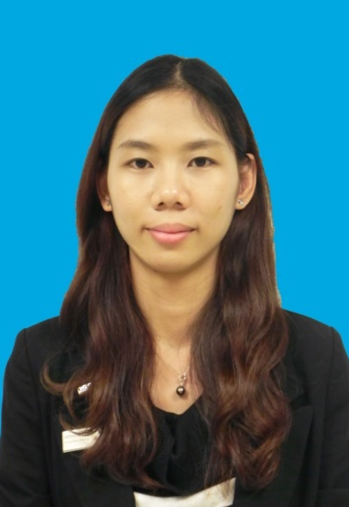
Outstanding Cares for Associate Award of May
五月杰出关爱员工奖
Jessica Chen
陈洁滢
HR
人力资源部
HR Officer
人力资源主管

Slide 3
Outstanding Cares for Associate Award of May
五月杰出关爱员工奖
2012年7月，我第一次离开家乡，到广州参加酒店实习。大部分同学被安排在餐饮部，我则被分配在人力资源部实习，对于陌生的环境，我对未来充满了好奇和未知。
I took part in the hotel internship in Guangzhou on July,2012. Most of my classmates were allocated in F&B，while I was in HR. At that time, my mind was filled with curiosity and uncertainty for this whole new environment.
在人力资源部实习，我主要负责招聘和培训两方面。Jessica是我在招聘方面的老师，如何约见面试、进行背景调查、面试的接待等等工作都是细心培训，耐心教导。在实习的过程中，不知道是不是自己的适应能力不够，前半段的实习自己总是会感觉到问题多多，自己也很苦恼。还记得因为自己在工作上可能存在不达标而会面临需要调离现实习岗位的困境，我听到这个消息的时候感觉快要崩溃了，虽然知道自己的工作表现理想，可是如何改进，让我陷入了迷茫。突然向迷失了方向，心一点点坠入冰窖，工作像没有了燃料的机器，没有了汽油的车辆，再也打不起精神来。
During the HR internship, I was mainly responsible for recruitment and training. Jessica was my supervisor in recruitment section. From interview, reference check and reception, she always guided me with patience. My first half of internship didn’t go really well.I felt very upset
about it. What’s more, I might be transferred for my poor
performance, I was frustrated and didn’t know what to do.
Jessica Chen
陈洁滢
HR
人力资源部
HR Officer
人力资源主管

Slide 4
Outstanding Cares for Associate Award of May
五月杰出关爱员工奖
就在这个艰难时刻，Jessica似乎感觉到了我工作精神状态不好的情况，那天，在上班的时候我记得她简单说了一句：晚上下班一起回宿舍吧。当时我还不以为然，继续工作。晚上下班之后才知道，由于上班时间都比较忙碌，除了工作很少有时间交谈，Jessica是特意今晚选择下班后找时间和我交谈。了解到因为自己工作表现不佳而困扰之后，除了安慰，Jessica首先让我回宿舍之后先写一个半年的工作总结，其中包括自己学到了什么，有什么不足需要改进的地方，以及对于和她一起共事过程中觉得可以改进的地方，希望通过这样一个方式找到自己的问题出在哪里。
Jessica sensed that I couldn’t focus on my work. One day, she came to me after work and talked about why don’t I write a report to summarize what you have learned, what you can improve that try to figure out the problem.
写完工作总结之后，Jessica针对这份总结和我坐下来慢慢进行分析，首先表扬我做的好的地方，让我不至于全盘否定自己的工作能力，开始找回自信。另外在工作需要改进的地方，我们一起讨论如何改进，Jessica想到要改进这些不足需要一个详细的实施计划，于是提出说：不如我们针对你工作上需要掌握的内容设定一个Natpc（新员工培训计划）吧？
She discussed about how to improve my work and helped me rebuild my
confidence. Besides, she also proposed a details plan
according Natpc specially focus on my work.
Jessica Chen
陈洁滢
HR
人力资源部
HR Officer
人力资源主管

Slide 5
Outstanding Cares for Associate Award of May
五月杰出关爱员工奖
在谈话找到工作中的问题之后，Jessica首先给我指定了一个详细的培训计划，，每天午饭之后的这段时间给我进行专项培训，争取改进自己的工作。在培训过程中，我能感觉到Jessica会专门制定符合我的培训接收方法，把培训的内容分层次详细讲解，一步一步把每件事情需要呈现的结果告知，了解到任务完成的具体标准，每次培训完都感觉自己工作恢复了斗志，充满信心。不仅是培训，培训后Jessica还会追踪跟进我再实际工作过程中是否会出现特殊情况需要帮助。
Jessica gave me a detailed training plan. After lunch every day, even though she was busy, she trained me seriously. Step by step, with Jessica’s help, now I could handle my work very smoothly, I could have never done that without her support.
我很感谢Jessica，实习这么久以来就像大姐姐一样关爱照顾我，让我觉得自己的实习获益良多，也学会了很多在课本上学不到的细节，让我更想在酒店业，在Starwood发展。很想通过这次机会对Jessica说声：谢谢你！
I really thanks Jessica from the bottom of my heart. She likes a sister who always be there for me . She makes me want to have develop in Starwood.Through this opportunity, I want to thank you Jessica.
Jessica Chen
陈洁滢
HR
人力资源部
HR Officer
人力资源主管
Nominated by 提名者：
Irene Zhang张盼, HR trainee人力资源部实习生

Slide 6
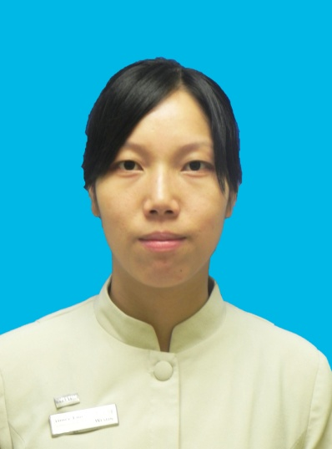
Outstanding Cares for Guest Award of May
五月杰出关爱客人奖
Aimee Luo
罗玉娣
ROOMS
房务部
Room Attendant
客房服务员

Slide 7
Outstanding Cares for Guest Award of May
五月杰出关爱客人奖
罗玉娣没有惊天动地的业绩，更没有耀眼夺目的荣誉，只是凭着满腔的热情，勤勤恳恳，无怨无悔的工作着，始终站在部门第一线，包揽着部门最重，最脏，最累的活。
Aimee Luo just a normal people but she kept her hard working without asking for any repayment.
2012年9月，罗玉娣来到了威斯汀酒店客房部工作，初到客房部工作，对工作不熟悉，她不懂就问，虚心向老员工学习，无论在旺季还是淡季，她总是用热情的微笑，端庄的举止出现在岗位前，让客人，同事感到亲切.记得我们酒店的VIP常客Mr. Adam Richard,每次都会住3501房，而且每次入住时间都是10天以上，他的要求很高，入住酒店时对各个部门都会有很多很多的投诉，当服务员们都很苦恼的时候，她向主管主动提出服务。因为她意识到客房服务员是酒店的形象窗口，稍有不慎，将会给客人造成无法挽回的损失，酒店的形象也会在客人心目中大打折扣，从而会失去一个回头客，作为客房部的一员，罗玉娣深感自己岗位的重要性。
Since Sep 2012, she joined the Westin Pazhou, she paid more attention to improved herself. In the process, she became more sociable. As we know Mr. Adam Richard is our regular guest, he always checked in Room3501, and he liked complaints about hotel’s service. Aimee Luo told the Shift Leader that she wanted to provided the service to Adam,
and she knew it will be the test which mean any mistake
to the service will affect the Housekeeping Team even
Hotel.
Aimee Luo
罗玉娣
ROOMS
房务部
Room Attendant
客房服务员

Slide 8
Outstanding Cares for Guest Award of May
五月杰出关爱客人奖
当他到客人房间时打扫卫生的时候，发现了客人的衣服都是叠整整齐齐的，意识到客人是个很有洁癖的人，然后她会帮客人把房间里的垃圾全部清理干净，而且把床上的布草都更换了，再打开mini bar发现客人消费了零度可乐，还有三盒特浓咖啡客人也喝了，当时其实她心里已经有底了，还在交班本里特别注明了零度可乐和咖啡，都把饮料和咖啡补齐了，第二天再一次打扫房间的时候，马上查酒水，咖啡，同样的酒水和咖啡，客人又有在消费，她马上知道了客人的喜好，马上申请多补几只零度可乐在客人房间。自从罗玉娣负责3501房间的服务后，就没有再听到客人的投诉了，此后只要是客人准备到店之际，罗玉娣都会先准备客人喜欢的零度可乐和咖啡，每次都得到客人的表扬，她的用心付出得到了应得的回报，每次客人都会肯定她的劳动成果，给予小费，昨天罗玉娣也得到了客人的100元人民币小费，而且还得到客人的感谢与赞扬。
When she cleaning the Room3501, she got the information about Adam’s favor. And according that, she provided Adam with personalized services. One day Aimee got 100RMB tips from Adam, we knew that Aimee wined the honor form Adam.
她就是这么个关爱客人的人，每次都会尽自己最大的努力做好每一件事，
Aimee cared the guests and tied her best in everything.
Aimee Luo
罗玉娣
ROOMS
房务部
Room Attendant
客房服务员

Slide 9
Outstanding Cares for Guest Award of May
五月杰出关爱客人奖
当客人眼里有一丝询问的时候，她会马上上前询问，“您好，我能为您做什么吗？”当遇到多变的天气时，她细心提醒客人多加衣服或别忘记带雨伞，没过多久，在领导和同事的帮助和关心下，他很快在业务上从内行变成了外行，在短时间内就掌握了工作的主动权。现在的她，不仅对清理客房的程序铭记在心，而且在清理时面面俱到，细致入微。在旅游旺季时，她打扫的房间，间间都是既快又干净，问她累不累，她总是乐呵呵的说：“再做几个房间也没问题。”
When she saw the guests，she smiled and greeted to them. When the
bad weather was coming, she reminded the guests to bring the umbrella and take care themselves. She was familiar with the job and didn’t complaint even though she was tired.
一份耕耘一份收获，罗玉娣就是这样，用一颗真诚，朴实的心去对待每一位客人，在让客人高兴而来，满意而归的同时，也为酒店赢得了不少的回头客，是我们学习的好榜样。
No pain no gain, Aimee used her sincere heart to show the care to the guests. She is our good example to us.
Aimee Luo
罗玉娣
ROOMS
房务部
Room Attendant
客房服务员
Nominated by 提名者：
Steven Wang王浪, Asst. Executive Housekeeper行政副管家

Slide 10
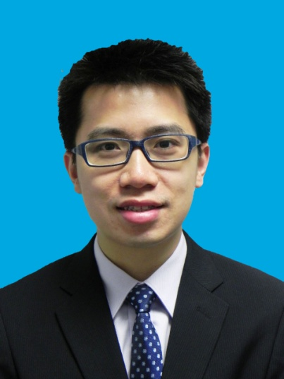
Outstanding Cares for Business Award of May
五月杰出关爱生意奖
Tinson Huang
黄天成
S&M
市场销售部
Sales Manager
销售经理

Slide 11
Outstanding Cares for Business Award of May
五月杰出关爱生意奖
销售经理黄天成主要负责客房销售，在4-5月份在房间收益方面销售额达212万，其中包括了广交会期间的长期客户，如：犹太人中心，ROSS（N.E.T. HONGKONG), KAEMINGK, NANTUCKET及五月份橡塑展期间的两个大型团队“埃克森美孚”和“博禄贸易”。值得一提的是，举办活动较为严谨的“埃克森美孚”，由于该公司管理层特别关注承办活动酒店方的安全问题，活动组织者曾三次到酒店就走火通道、避难层等安全问题与酒店协商，TINSON每次都尽责任地陪客人走遍酒店并准确地记录客人要求，与相关部门进行沟通、解决问题。在“埃克森美孚”和“博禄贸易”入住期间，Tinson每晚凌晨还在酒店跟进相关协调工作，其中一个晚上，组织者与凌晨两点多还在电话上与Tinson沟通第二天的活动安排 。Tinson说：累，但满足！
Marketing manager Tinson Huang is in charge of rooms sales, making rooms sales revenue reached 2.12 million during April to May, which included the regular guests of Canton Fair, eg. Jewish Centre, ROSS（N.E.T. HONGKONG), KAEMINGK, NANTUCKET and two big groups of Chinaplas:” XOM(Exxon Mobil)” and “Borouge”. “Borouge” were very serious about this activities, so the activity organizers had talked about security issues with hotel for three times and Tinson communicated with them earnestly. There was a time , he stayed to two o’clock
in the morning arranging the next day’s activity. Tinson
said: tired, but satisfied.
Tinson Huang
黄天成
S&M
市场销售部
Sales Manager
销售经理

Slide 12
Outstanding Cares for Business Award of May
五月杰出关爱生意奖
对于每一个客户，他们都希望自己是最受关注的，故此他们都会常常过来酒店参观，与酒店的销售人员确认活动的细节，而TINSON总是耐心地等待每一位顾客，计划好所有的准备工作，甚至不惜牺牲自己周末的休息时间回到酒店，跟客户和酒店内部的相关部门进行协调，让每个顾客都能感受到他个性化和直觉灵动的服务。
Every customer wants to be care, so they would like to visit the hotel and make sure the details of activities. Tinson Wang always waits every guest in patient, does prepare work, even sacrifices his weekends coordinating with guests and related department in hotel, which makes every customer feel his personalized and instinctive service.
2013年4月27日，本应休息的TINSON得知在竞争对手酒店中有一个非常有潜力的新客户---NYGARD GROUP，是全球500强的服装企业，这是他们第一次来到广州参加广交会，而且住的都是非常高级的套房，
On April the 27th,2013, Tinson got to know the rival hotel had a very potential new customer --NYGARD GROUP, which is a world top 500 clothing enterprise participating in Canton Fair for the first time.
Tinson Huang
黄天成
S&M
市场销售部
Sales Manager
销售经理

Slide 13
Outstanding Cares for Business Award of May
五月杰出关爱生意奖
因此TINSON用尽了所有的方法去查到了公司的背景，然后顺藤摸瓜地找到了负责差旅安排的联系人，继而费尽唇舌地把客人吸引到酒店参观，经过酒店管理层与TINSON的共同努力，最后成功地把客人在竞争对手酒店的生意全部转移过来，总收入为人民币15万元。客人离店时还要求TINSON帮他们预订在之后一个星期到深圳出差的用房，为姐妹酒店深圳益田威斯汀酒店带来约18,300美元的客房收入。客人最后还承诺以后在广州出差将会优先考虑选择广交会威斯汀酒店,目前在六月份的照明展期间已接到NYGARD GROUP七间房住四天的预订。
Tinson tried his best finding that enterprise’s background and their contact person in charge of travel Arrangement and attract them visiting our hotel. Finally, with the effort of Tinson and hotel management team, we managed to attract the whole business of that group change to our hotel, which made us RMB150 thousand revenue. When they left the hotel ,they even asked Tinson to help them do a reservation for their business trip a week later in Shenzhen, which making our sister hotel US$18 thousand revenue. They also promised us that they would put our hotel as their first choice next time they went to Guangzhou. Now they have already reserved seven rooms for four days in our hotel during the Light Fair in June.
Tinson Huang
黄天成
S&M
市场销售部
Sales Manager
销售经理

Slide 14
Outstanding Cares for Business Award of May
五月杰出关爱生意奖
TINSON常说客户的开心和感谢就是对他最大的肯定和认可，再辛苦也是值得的。他经过不懈的努力，出色地完成了销售指标，也同时为酒店下半年的生意做足了准备功夫。
Tinson always said that the happiness of and thanks from customers is the greatest inspiration for him. With his hard work, he reached his sales targets particularly well, and did a great preparation for the rest half year of hotel’s business.
Tinson Huang
黄天成
S&M
市场销售部
Sales Manager
销售经理
Nominated by 提名者：
Amy Deng邓翠鸣, Director of Sales销售总监

