Slide 1
Starwood Cares Recognition
Award for September 2013
喜达屋关爱奖励计划获奖名单 - 9月

Slide 2
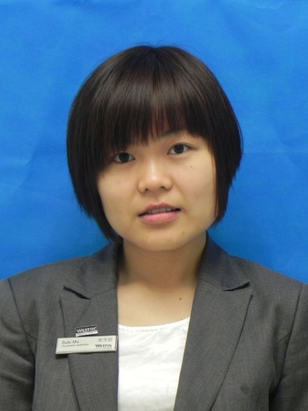
Outstanding Cares for Associate Award of September
九月杰出关爱员工奖
Suki Mo
莫秀健
F&B
餐饮部
Team Leader - FiveZen5es中国元素餐厅主管

Slide 3
Outstanding Cares for Associate Award of September
九月杰出关爱员工奖
关爱如一股清泉滋润人们的心田；关爱如一缕阳光温暖人们的身心；关爱更如一杯清茶让人们品味它的清纯。这两年来，谢谢一直有你的陪伴和帮助。莫秀建Suki，谢谢你每一次在紧急关头给予我们的帮助。在工作的历程中，她都是默默无闻，从不计较工作做多做啥少的人。对待客人热情，细心，工作认真负责，因此也常常成为我们学习的好 榜样，上司眼里的好下属。
Cares like a fresh spring moisten people's hearts. Cares like a ray of sunshine warm people's body and mind. Cares is more like a cup of green tea. It will make people taste the pure. In these two years, thanks for your company and help. Suki Mo, thanks your help every time while emergency. She is in obscurity, who regardless the work more or less during the work. She handled the guest with enthusiasm, careful, serious and responsible. So that she's our idol in my eye.
Suki Mo
莫秀健
F&B
餐饮部
Team Leader - FiveZen5es中国元素餐厅主管
Nominated by 提名者：
Rose Mei梅桂, Team Leader - FiveZen5es中国元素餐厅主管

Slide 4
Outstanding Cares for Associate Award of September
九月杰出关爱员工奖
9月7号深夜，我突然发起了高烧，喉咙发炎刺激到我的耳朵听力急速下降，耳朵刺痛得揪心，我坐立不安，平常没有备好感冒发烧的药，情急中我拨通了Suki的电话，：“小莫，你有退烧药吗？我发烧了，你那有退烧药吗..’’.话没说完，她就应我马上送药过来给我，让我稍等一会。五分钟左右，她来到了我宿舍，给我测了温度计，拿来温水和退烧片给我服。半个小时过去了，发现我没有任何好转，于是她说：“烧不退，梅桂我们打车去医院吧！再这样子下去会把你脑袋给烧坏的。”与生俱来就怕打针的我毅然拒绝了她的请求。她拿我没主意，只好又冲了两包金银花冲剂给我喝了下去，十多分钟过后，我耳朵的刺痛得到了缓解，虽然高烧还没退下来,但是身体感觉好多了。
Sep 7th evening, I got a high fever, the throat was sore and I felt couldn’t hear and ear also felt hurt. I was nervous and upset. But I didn't have any medicine, so I called Suki. She said she would send the medicine to me right away. After 5 minutes, Suki brought some medicines to me and helped me to test the temperature. Also she asked me to take the medicine with warm water. After half an hour, I didn’t feel better. But Suki said it would be dangerous if I kept having the high fever. She wanted to bring me to the hospital. However, I was afraid injection. So I rejected her suggestion. She prepared some Chinese herbal tea for
me. Several minutes past, my ear felt better but I still
having high fever.
Suki Mo
莫秀健
F&B
餐饮部
Team Leader - FiveZen5es中国元素餐厅主管

Slide 5
Outstanding Cares for Associate Award of September
九月杰出关爱员工奖
这时候我看了一下表，原来已经深夜4点了，她明天还得7点钟起来上班。“小莫，你回去休息吧，我好的差不多了，你明天还得上早班，谢谢你，辛苦了，我再歇一会喝杯水就去睡。”无论我怎么说她都不愿意走，她把我扶到床边，让我躺下给我盖好被子，敷了湿毛巾，慢慢哄我入睡。在她离开的时候，朦朦胧胧的我看到钟已经是5点了。第二天起来我的烧已经退了。我非常感谢小莫，虽然感谢的话有很多，在这里只化作简单的几个字：“小莫，谢谢您，辛苦了。”事后，她知道我需要上医院复诊，煮药。所以把我的班都改早班，好让我早点回家休息，谢谢你的悉心照顾及安排，让我感觉到家人的温暖。
It was 4.00am and Suki need to go to work on 7AM next day. So I said I had better and you should go back for a rest. You need to on duty tomorrow. No matter what I said, she insisted to accompany with me until my fever is gone. She covered the quilt for me, put the cold towel on my forehead. She left at about 5:00. After that she knew I need to go to the hospital for the return visit, she arranged me to be the morning shift. Thank you for your cares. It makes me feel warm like a family.
Suki Mo
莫秀健
F&B
餐饮部
Team Leader - FiveZen5es中国元素餐厅主管

Slide 6
Outstanding Cares for Associate Award of September
九月杰出关爱员工奖
9月14号星期天我突然听到家里的来电：“婆婆进了医院，如果你方便的话去看看她吧，要做大手术。” 这一天的预订比较多，而我本来已经安排好上班的，因为我上星期发烧没痊愈，所以小莫帮我顶了班，只能休息一天，但是她在旁边得知我亲戚在医院，需要人去照顾后，二话没说，给经理打了电话：“Tracy，梅桂她亲戚进了医院，病情有点严重需要人照顾，我今天休假帮她顶班可以吗？”这一刻，我的泪水终于忍不住哗啦啦的流下来了。千言万语尽在不言中，无论是工作还是生活，你总是把别人放在第一位，而自己什么都觉得无所谓。
Sep 14th Sunday, I received a phone from my home. It said that my grandma was hospitalized. And it may need to have an operation. They hoped me go back home. That day was very busy. And I was had a high fever before. So Suki arranged me off and acted as my stand-in last week. She only took one day off. But when she knew the situation of my grandma and need me home. She called Tracy and she would stop her off letting her back to work instead of me. I was so moved to tear.
Suki Mo
莫秀健
F&B
餐饮部
Team Leader - FiveZen5es中国元素餐厅主管

Slide 7
Outstanding Cares for Associate Award of September
九月杰出关爱员工奖
9月17号我休了长假回家，平常我负责的工作内容有得交给她帮我跟进了，面对排班，考勤，新菜式的加键，仪容仪表的监督检查等等一些繁琐的工作她都一个人承担了。小莫感人的事迹还有很多很多，在工作上她就如大海上的海星一样，虽然沙滩上都是海星，但是她不怕因为她靠自己而被回到大海中继续发光发亮！每一次她都很出色地完成工作。她的精神值得我们远播。
Sep 17th, I asked for leave and go home. Suki helped me to follow all things when I absence. Arranged the roster, attendance record and added the new article for dishes, checked the grooming. Thank you, Suki , for all the things. There are so many touching things and she worked very carefully. I nominate her for cares associates’ award.
Suki Mo
莫秀健
F&B
餐饮部
Team Leader - FiveZen5es中国元素餐厅主管

Slide 8
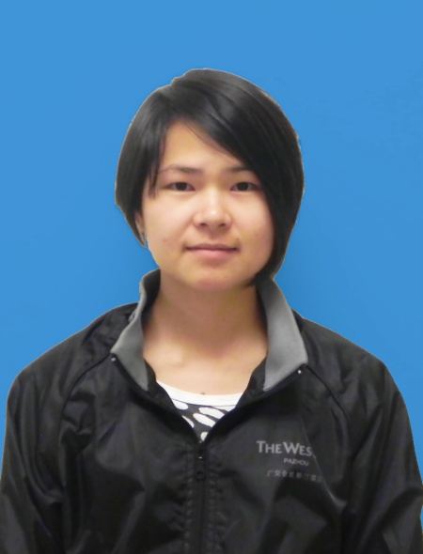
Outstanding Cares for Guest Award of September
九月杰出关爱客人奖
Cindy Su
苏妹
F&B
餐饮部
Service Attendant – SeasonalTaste
知味西餐厅服务员

Slide 9
Outstanding Cares for Guest Award of September
九月杰出关爱客人奖
酒店是我们出门在外的第二个家，个性化的服务总能让我们流连忘返。Ms.Mundhra说过我们的酒店每次都能给她家的感觉，因此来中国入住广交会威斯汀酒店就等于回家。这都归功于我们酒店的每位同事，苏妹就是其中的一员。
Ms.Mundhra said she stay in our hotel as comfortable as she stay at home. Every time she came china she will chose Westin Pazhou which like her home. Thanks to all the staff in seasonal tastes offer personality service for Ms Mundhra, especially Cindy Su.
Ms.Mundhra英文不是很好，来异国最让她头疼的就是饮食问题。而又因为她是穆斯林，所以很多食物是不可以食用的。每次去吃饭都需要折腾了很久才能吃上自己可以食用的菜肴。很幸运的是在我们餐厅总能满足她的需求并能提前帮她准备好她想吃的食物，因为我们有同事能给她小感动。
Ms Mundhra’s English is not very good, and she is a muslin, so it a trouble for her to have dinner in China, it’s hard to communicate and choose the food suitable for her. it’s so lucky seasonal tastes can achieve her request and prepare the food in advance.
Cindy Su
苏妹
F&B
餐饮部
Service Attendant – SeasonalTaste
知味西餐厅服务员
Nominated by 提名者：
Ada Xie谢宏娟, Captain – SeasonalTaste知味西餐厅领班

Slide 10
Outstanding Cares for Guest Award of September
九月杰出关爱客人奖
在2013年9月18日，MS Mundhra出差到广州，因此选择入住了我们广交会威斯汀酒店，苏妹服务MS Mundhra时发现她是穆斯林客人，从以往服务穆斯林客人中吸取经验。她主动的向其推荐既具有广东特色又符合MS Mundhra口味要求的主食---橄榄油时蔬炒面，并征求客人的意见后立马告知厨师制作，并且还特意叮嘱师傅一定要用清洗干净的、无接触过肉类的锅单独炒。当菜肴呈给客人时她还特地解释了其做法与用料。MS Mundhra对于苏妹的推荐甚是满意。苏妹从服务的过程中还发现MS Mundhra每次都会站在面包档口许久才回座位。
On Sep 18th,2013, Ms Mundhra came to Guangzhou for business trip, she stayed in our hotel. When Cindy service Ms Mundhra, she find out she is a muslin, so she pay more attention as she has the experience to serve the Muslin before. Cindy recommend Ms Mundhra to try Fried noodles with Olivia oil and seasonal vegetables, which dish has Guangdong Feature and suitable for muslin taste. After she get the confirmation from Ms Mundhra, she ask chef to prepare at once, and remind the chef to use the clean pot which didn’t cooked pork before to do the fried noodles. When Cindy serve the noodles to Ms Mundhra she explain the cooking procedure and the ingredients, Ms Mundhra was very satisfied. Also Cindy find out Ms Mundhra always stand in front of the pastry station for long times before go back to the table.
Cindy Su
苏妹
F&B
餐饮部
Service Attendant – SeasonalTaste
知味西餐厅服务员

Slide 11
Outstanding Cares for Guest Award of September
九月杰出关爱客人奖
细心的她一下子明白了MS Mundhra只吃新鲜出炉的Waffle配枫叶糖浆。MS Mundhra在店期间，苏妹一见到MS Mundhra来餐厅，总是在第一时间吩咐饼房的同事立马现做一份Waffle，并且亲自送到Mundhra的餐桌上。MS Mundhra特别吃惊苏妹的这一举动，她非常惊讶苏妹能预知她的需求。在MS Mundhra入住期间，如果苏妹休息了，她就会特地交代早班的同事来跟进。每个细节都交接的特别清楚。
Also Cindy find out Ms Mundhra always stand in front of the pastry station for long times before go back to the table. Cindy knew Ms Mundhra must like to eat the fresh waffle with syrup, every time she standing there is waiting for chef to cook the waffle. After that, when Ms Mundhra came to restaurant, Cindy will ask the chef to cook the waffle for Ms Mundhra in first time. And deliver to Ms Mundhra in person. Ms Mundhra was so surprise Cindy know what her want in advance. During Ms Mundhra stay in our hotel, sometimes Cindy took off but she also will share the information with our morning shift associates, so that we call follow up and still can offer the personality service for Ms Mundhra
苏妹就是这样用心来服务每位来餐厅的客人。因此，我提名她关爱客人奖。
Cindy Su is the associate who care every guest come to
Westin Pazhou. So that I nominate her to be the
outstanding cares for guest award.
Cindy Su
苏妹
F&B
餐饮部
Service Attendant – SeasonalTaste
知味西餐厅服务员

Slide 12
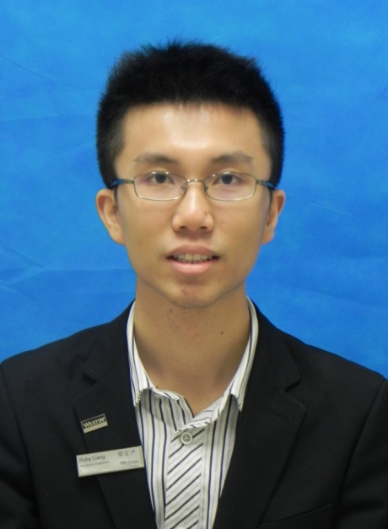
Outstanding Cares for Business Award of September
九月杰出关爱生意奖
Dominic Feng
冯天佑
S&M
市场销售部
Event Executive
宴会统筹主任

Slide 13
Outstanding Cares for Business Award of September
九月杰出关爱生意奖
冯天佑作为我们市场销售部的宴会统筹主任，自2012年二月份入职以来，凭借他认真负责的工作态度，获得了同事们的一致认可，同时也获得了客人们的一致赞赏。
Since February 2012, Event Executive of S&M, work hard and get a great appreciates both from associates and guests.
8月31日，休息在家的Dominic接到了一项非常艰巨的任务 — 接待宝洁团队。由于那几天我的身体感到不适，医生建议要在家休养几天，可是同时这几天正正是宝洁团队的入住与会议最重要的筹备。我非常需要一位同事代替我去统筹和协助接下来连续三天的宝洁团队的事宜，Dominic二话不说就接受了这个艰巨的任务。
Dominic received a very difficult task to receive P&G team at 31st August when I was feeling bad. The doctor ask me to have a rest at home for a few days. But as the P&G task come to an important stage, I need someone to handle the meeting for me. Dominic take the task without saying anything.
Dominic Feng
冯天佑
S&M
市场销售部
Event Executive
宴会统筹主任
Nominated by 提名者：
Maggie Wen文静, Asst. Director of Event宴会统筹副总监

Slide 14
Outstanding Cares for Business Award of September
九月杰出关爱生意奖
这次的活动是宝洁的年度亚太区高层颁奖会议，出席的人员除了来自不同国家的宝洁公司的精英以外，还有宝洁公司的VP Mr. Hunter 以及著名的演讲家 Mr. Kaufman。为了隆重其事，宝洁公司安排多达8人组成了庞大的活动组织统筹团队，每个人负责的范围都不一样，这也就意味着我们的这位同事需要跟8个会议组织人员沟通、协商。心思细密、认真负责、吃苦耐劳是接受这一任务的同事的必备条件，Dominic恰好用这份精神赢得了客户的赞美与掌声。大量房间入住的安排与客户临时的更改要求与决定可以说让人头晕脑胀；宝洁团队的会议一向都是要求最高的，会议的安排与细节都非常的细致，每一个小的点我们都不能忽略掉，这样无形中也给对接的销售人员相当大的压力；
This activity is the annual Asia Pacific awards conference of P&G and the attendants is from all over the world include the famous orator Mr. Kaufman. P&G arranged a 8 people team to handle this big meeting. That means we need to talk with 8 different people. Everyone work in different area so that Dominic need to communicate with 8 different people. To be thoughtful and careful is the character of a sales man. Dominic win the praise with his own character. The P&G team required high level of room services. We shouldn’t miss anything and it give press to the sales as well.
Dominic Feng
冯天佑
S&M
市场销售部
Event Executive
宴会统筹主任

Slide 15
Outstanding Cares for Business Award of September
九月杰出关爱生意奖
用餐方面更是需要更加的宝洁公司非常关注的环节，由于宝洁公司宴请的都是来自世界各国有着不同的文化、背景的重要客户与领导，说到饮食方面，他们肯定会更加谨慎与关注。除此之外，上至房间与会议安排，下至接送安排与会议后的结账、发票问题，Dominic都亲自跟进，务求让客人的整个入住都体验非凡与满意。这段时间的Dominic都奔跑在酒店的每一个角落，只要客人需要的时候，他就会第一时间现身。从早上7点多到晚上11点，这个不知疲倦的身影总先把客人的问题与需要解决了再想到自己。每次同事们叫Dominic一起去饭堂吃饭的时候，他总是笑笑的说：“我最近减肥，你们先去吧”，然后又回到座位前埋头苦干，一干就是八点多九点才想起自己还没吃晚饭。本来在我们团队中就是最瘦弱的他，却往往在这个时候体现出他庞大的能量与爆发力。
The P&G team required high level of F&B services too. The P&G team invite guests from all over the world with different culture. During this period, Dominic is running in every corner of the hotel. Whenever the guests need, he will appear. He consider the guests needs first and then think of himself. Every time we ask him to join us with dinner, he smile and say he is losing weight. He always work to 8 or 9 pm in the evening. It shows his energy and power at the thin body.
Dominic Feng
冯天佑
S&M
市场销售部
Event Executive
宴会统筹主任

Slide 16
Outstanding Cares for Business Award of September
九月杰出关爱生意奖
MPSI – Meeting Planner Satisfaction Index，“会议组织者满意指数回访”。这个也是鼓励着和监督着我们每一个宴会销售同事的服务。每一次的会议满意指数回访，宝洁给我们的得分都难以完全满意，总会有那么一点点的瑕疵和意外。但是这次，完美的满分5分与客人高度的评价，给予了我们Dominic完全的肯定与赞赏，他的应变能力、问题处理能力、沟通能力让客人这次的入住与会议在广交会威斯汀酒店顺利的完成。
MPSI encourage the sales team. But it is hard to get a full mark. But this time by Dominic’s hard working we get full mark and receive a great comment from the P&G team. He help us a lot with all his character.
通过Dominic的努力，为酒店9月一开始就带来了15万多的客房收入与25万多的宴会收入，总共超过了40万元的收入为9月份的生意一开始打了一支强心针。感谢我们团队中有这么一位同事、这么一份精神、这种不一样的态度。我提名Dominic为9月月度杰出关爱生意奖。
By Dominic’ hard working, we get more than 150000 guest rooms revenue and more than 250000 event revenue. This is a huge shot in the arm to the business at the beginning in September. So I nominate Dominic to be the outstanding care business.
Dominic Feng
冯天佑
S&M
市场销售部
Event Executive
宴会统筹主任

