Slide 1
Starwood Cares Recognition
Award for Third Quarter
喜达屋关爱奖励计划获奖名单 – 第三季度

Slide 2
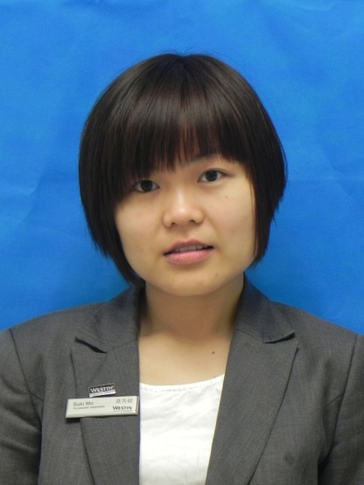
Outstanding Care for Associate Award - Third Quarter
第三季度杰出关爱员工奖
Suki Mo
莫秀健
F&B
餐饮部
Team Leader - FiveZen5es中国元素餐厅主管

Slide 3
Outstanding Care for Associate Award - Third Quarter
第三季度杰出关爱员工奖
关爱如一股清泉滋润人们的心田；关爱如一缕阳光温暖人们的身心；关爱更如一杯清茶让人们品味它的清纯。这两年来，谢谢一直有你的陪伴和帮助。莫秀建Suki，谢谢你每一次在紧急关头给予我们的帮助。在工作的历程中，她都是默默无闻，从不计较工作做多做啥少的人。对待客人热情，细心，工作认真负责，因此也常常成为我们学习的好 榜样，上司眼里的好下属。
Cares like a fresh spring moisten people's hearts. Cares like a ray of sunshine warm people's body and mind. Cares is more like a cup of green tea. It will make people taste the pure. In these two years, thanks for your company and help. Suki Mo, thanks your help every time while emergency. She is in obscurity, who regardless the work more or less during the work. She handled the guest with enthusiasm, careful, serious and responsible. So that she's our idol in my eye.
Suki Mo
莫秀健
F&B
餐饮部
Team Leader - FiveZen5es中国元素餐厅主管
Nominated by 提名者：
Rose Mei梅桂, Team Leader - FiveZen5es中国元素餐厅主管

Slide 4
Outstanding Care for Associate Award - Third Quarter
第三季度杰出关爱员工奖
9月7号深夜，我突然发起了高烧，喉咙发炎刺激到我的耳朵听力急速下降，耳朵刺痛得揪心，我坐立不安，平常没有备好感冒发烧的药，情急中我拨通了Suki的电话，：“小莫，你有退烧药吗？我发烧了，你那有退烧药吗..’’.话没说完，她就应我马上送药过来给我，让我稍等一会。五分钟左右，她来到了我宿舍，给我测了温度计，拿来温水和退烧片给我服。半个小时过去了，发现我没有任何好转，于是她说：“烧不退，梅桂我们打车去医院吧！再这样子下去会把你脑袋给烧坏的。”与生俱来就怕打针的我毅然拒绝了她的请求。她拿我没主意，只好又冲了两包金银花冲剂给我喝了下去，十多分钟过后，我耳朵的刺痛得到了缓解，虽然高烧还没退下来,但是身体感觉好多了。
Sep 7th evening, I got a high fever, the throat was sore and I felt couldn’t hear and ear also felt hurt. I was nervous and upset. But I didn't have any medicine, so I called Suki. She said she would send the medicine to me right away. After 5 minutes, Suki brought some medicines to me and helped me to test the temperature. Also she asked me to take the medicine with warm water. After half an hour, I didn’t feel better. But Suki said it would be dangerous if I kept having the high fever. She wanted to bring me to the hospital. However, I was afraid injection. So I rejected her suggestion. She prepared some Chinese herbal tea for
me. Several minutes past, my ear felt better but I still
having high fever.
Suki Mo
莫秀健
F&B
餐饮部
Team Leader - FiveZen5es中国元素餐厅主管

Slide 5
Outstanding Care for Associate Award - Third Quarter
第三季度杰出关爱员工奖
这时候我看了一下表，原来已经深夜4点了，她明天还得7点钟起来上班。“小莫，你回去休息吧，我好的差不多了，你明天还得上早班，谢谢你，辛苦了，我再歇一会喝杯水就去睡。”无论我怎么说她都不愿意走，她把我扶到床边，让我躺下给我盖好被子，敷了湿毛巾，慢慢哄我入睡。在她离开的时候，朦朦胧胧的我看到钟已经是5点了。第二天起来我的烧已经退了。我非常感谢小莫，虽然感谢的话有很多，在这里只化作简单的几个字：“小莫，谢谢您，辛苦了。”事后，她知道我需要上医院复诊，煮药。所以把我的班都改早班，好让我早点回家休息，谢谢你的悉心照顾及安排，让我感觉到家人的温暖。
It was 4.00am and Suki need to go to work on 7AM next day. So I said I had better and you should go back for a rest. You need to on duty tomorrow. No matter what I said, she insisted to accompany with me until my fever is gone. She covered the quilt for me, put the cold towel on my forehead. She left at about 5:00. After that she knew I need to go to the hospital for the return visit, she arranged me to be the morning shift. Thank you for your cares. It makes me feel warm like a family.
Suki Mo
莫秀健
F&B
餐饮部
Team Leader - FiveZen5es中国元素餐厅主管

Slide 6
Outstanding Care for Associate Award - Third Quarter
第三季度杰出关爱员工奖
9月14号星期天我突然听到家里的来电：“婆婆进了医院，如果你方便的话去看看她吧，要做大手术。” 这一天的预订比较多，而我本来已经安排好上班的，因为我上星期发烧没痊愈，所以小莫帮我顶了班，只能休息一天，但是她在旁边得知我亲戚在医院，需要人去照顾后，二话没说，给经理打了电话：“Tracy，梅桂她亲戚进了医院，病情有点严重需要人照顾，我今天休假帮她顶班可以吗？”这一刻，我的泪水终于忍不住哗啦啦的流下来了。千言万语尽在不言中，无论是工作还是生活，你总是把别人放在第一位，而自己什么都觉得无所谓。
Sep 14th Sunday, I received a phone from my home. It said that my grandma was hospitalized. And it may need to have an operation. They hoped me go back home. That day was very busy. And I was had a high fever before. So Suki arranged me off and acted as my stand-in last week. She only took one day off. But when she knew the situation of my grandma and need me home. She called Tracy and she would stop her off letting her back to work instead of me. I was so moved to tear.
Suki Mo
莫秀健
F&B
餐饮部
Team Leader - FiveZen5es中国元素餐厅主管

Slide 7
Outstanding Care for Associate Award - Third Quarter
第三季度杰出关爱员工奖
9月17号我休了长假回家，平常我负责的工作内容有得交给她帮我跟进了，面对排班，考勤，新菜式的加键，仪容仪表的监督检查等等一些繁琐的工作她都一个人承担了。小莫感人的事迹还有很多很多，在工作上她就如大海上的海星一样，虽然沙滩上都是海星，但是她不怕因为她靠自己而被回到大海中继续发光发亮！每一次她都很出色地完成工作。她的精神值得我们远播。
Sep 17th, I asked for leave and go home. Suki helped me to follow all things when I absence. Arranged the roster, attendance record and added the new article for dishes, checked the grooming. Thank you, Suki , for all the things. There are so many touching things and she worked very carefully. I nominate her for cares associates’ award.
Suki Mo
莫秀健
F&B
餐饮部
Team Leader - FiveZen5es中国元素餐厅主管

Slide 8
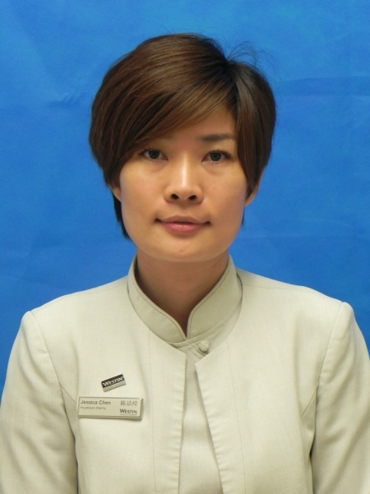
Outstanding Care for Guest Award - Third Quarter
第三季度杰出关爱客人奖
Lisa Li
李冬丽
ROOMS
房务部
Head Therapist
首席理疗师

Slide 9
Outstanding Care for Guest Award - Third Quarter
第三季度杰出关爱客人奖
Lisa是水疗中心的首席理疗师。在平时的工作中除了要做好自己对客服务的分内事，还会负责理疗师的培训指导并向团队的服务和收益多次提供良好的建议和意见。可谓以身作则，事无巨细。同时，Lisa一直以来以关心客人需求为最大闪光点，备受客人好评。
Lisa is the chief therapist of Heavenly SPA .In the usually ,Lisa will do her routine customer service job, on the other hand, she needs to be responsible for therapist training guide and provide good suggestions and opinions to the service and benefit team. She is always being a good example for caring guests and highly commended by our guests.
这是七月份的一个普通的工作日，正常理疗师上班的时间是下午三点钟。因为接到客人钱先生十点钟的预订，Lisa九点半钟早早地来到水疗中心，为客人的到来做着充足的准备。钱先生是我们的会员，但是Lisa也没有掉以轻心，从在前台迎接客人一直到最后送走客人，
One day of July, The duty time of Therapist is 15:00 pm. Lisa came to Spa earlier to prepare the treatment room for the guest at 9:00,The guest made the appointment for the treatment at 10:00. Mr. Qian who is a member of our spa, Lisa was careful to do every details for the guest.
Lisa Li
李冬丽
ROOMS
房务部
Head Therapist
首席理疗师
Nominated by 提名者：
Sheri Xia夏媛, Asst. SPA Manager 水疗中心副经理

Slide 10
Outstanding Care for Guest Award - Third Quarter
第三季度杰出关爱客人奖
一丝不苟地按照我们的服务标准一一进行着。原本钱先生只预订了一个60分钟的身体按摩和45分钟的身体磨砂护理。但感觉Lisa的手法非常好，人也特别放松。于是再加多1个小时的按摩和一个小时的面部护理。一共是4个小时！这对个人的体力是一个非常大的挑战，而且已经到了午饭时间，同事们也为Lisa打包了中饭上来，可是Lisa考虑到客人所希望得到的服务是连贯且一气呵成， Lisa没有向客人要求中间休息一下。就这样，客人体验到一个非常连贯而优质的服务，而此时已经是下午2点半了。同时，也为我们带来将近3000元的收益。
From the guest arriving to the end of his treatment, she followed the process operation, because of the high quality service, Mr.Qian added for one more hour body massage and one more hour facial basis on his original treatment, totally was four hours. In order to ensure the treatment accomplished with high quality, Lisa did not eat lunch until the treatment finished at 2:30 pm, at the same time ,Lisa let our spa income CNY3000.
在送走钱先生的时候，他很满意地对我们说，其实他是长居在北京的商务人士，也会经常出差来到广州。
When we had farewell with Mr.Qian, he was very satisfied and told us his Westin complex, he is a business man who are living in
Beijing.
Lisa Li
李冬丽
ROOMS
房务部
Head Therapist
首席理疗师

Slide 11
Outstanding Care for Guest Award - Third Quarter
第三季度杰出关爱客人奖
广州的所有国际5星级酒店，他都有光临过，包括在北京的时候他也住过威斯汀酒店。但他独独选择并且十分中意广交会威斯汀酒店，就是因为这里的水疗服务确实很不一样。我们的员工很能感同身受，能够真正做到尽心尽力地提供给客人最美好的体验。因为总是要出差所以喜欢来到水疗做一些放松的项目而且理疗时间时间都比较长，大部分的理疗师也到了三个钟头的时候已经体力不支，力度有所变化。而这次，Lisa给他的体验是由始至终感受都非常好，没有任何懈怠。并且还向他介绍了平日如何用相关的动作和食物来保健自己的颈椎，避免过度劳损带来的伤害。就是这些原因，这样亲切而体贴的服务，即便不是本地人，他也会选择成为我们的会员。
He has came to Guangzhou of many times, and he has visited all the international five star hotel in Guangzhou, including the Westin Beijing, but he is still very like and had choose the Westin Pazhou, because of the High quality spa service. Many therapists can only provide 3 hours massage and end with a little bit tired, therefore, he felt as not good as the beginning. However, Lisa left him a very good expression. We served him well not only every time, even every minute he loved and enjoyed so much. Lisa also introduced some food and yoga poses to protect the back and neck. That is why he wants to join to be our spa membership; even he is not a local person.
Lisa Li
李冬丽
ROOMS
房务部
Head Therapist
首席理疗师

Slide 12
Outstanding Care for Guest Award - Third Quarter
第三季度杰出关爱客人奖
Lisa就是这样尽心尽力地为每一位客人提供着高质量的服务。这天是一位来自香港的白金卡客人陈先生，订了一个客房包价的促销优惠。晚上十点如约来到了水疗中心，这回又是Lisa帮忙接待。整个过程的体验，陈先生非常满意。当即就跟我们说，之前就很喜欢威斯汀，一直也是住天河那一边。这边主要是晚上没有什么逛街的地方，但是这次我的水疗体验非常好，尤其是Lisa在过程中与擅长聊天的陈先生沟通了很多养生之道，比方说陈先生经常会失眠，Lisa就介绍了用相关促进安定和睡眠的精油来香薰，其次就是介绍了一些巩固神经放松的穴位自己可以多多按摩，受益匪浅，以后肯定常常来了。明天还想加多一个套餐，但是第二天中午12点就得退房赶回香港，不知道你们能不能安排到呢。
Lisa is committed to provide every guest of a high quality of service. This day, have a guest name is Mr Chen who is coming from Hong Kong, one P member in our hotel, he booked a room package including our spa of 60 minutes signature massage. So he is arrived in spa at 10:00 pm, Lisa welcomed the guest n the spa front desk, Mr.Chen was very satisfaction with whole procedure ,said to us he likes The Westin Resort, always living in The Westin Guangzhou, but he will consider staying in our Westin Pazhou next time ,because this time he had a fantastic experience in our spa. And he learned a lot from Lisa, she told him about the essential oil is good for sleep and with some massage on the accupoint.
“Can I request another treatment tomorrow. But I will
back HK, So I need check out at 12:00”Mr.Chen said, “
Lisa Li
李冬丽
ROOMS
房务部
Head Therapist
首席理疗师

Slide 13
Outstanding Care for Guest Award - Third Quarter
第三季度杰出关爱客人奖
Lisa这时毫无犹豫回答，没问题的，您的光顾就是我们无比的荣幸，随时都欢迎您的到来。就这样夜晚凌晨一点下班的Lisa，第二天9点又赶回来加班只为陈先生提供了另一次美好的水疗体验。陈先生在退房的时候跟我们的前台同事说，Lisa真是太棒了，不仅仅是她的手法和专业度，更重要的是，她会担当起自己的工作职责并且能与客人有着非常平实亲切的交流。在这里，做按摩的项目，不仅仅身体得到放松，在体验中彼此的交谈和沟通让他感觉好像来到一个温暖的大家庭。
Of course, that is our honor can service you again ,welcome you coming of every time” Lisa answered, That day Lisa was off work at 01:00 ,then, next day morning at 9 o’clock to provide a wonderful experience for Mr.Chen, When Mr.Chen left our spa and told our spa colleague. He really loved here, not only for our excellent service, but also we communicate with him like we are the family. He is not longer a guest in Guangzhou.
Lisa Li
李冬丽
ROOMS
房务部
Head Therapist
首席理疗师

Slide 14
Outstanding Care for Guest Award - Third Quarter
第三季度杰出关爱客人奖
Lisa就是一位关心客人的优秀代表。一直以来，Lisa工作态度一丝不苟，勤勤恳恳，凡是以客人和生意为先。多次获得客人的赞赏，水疗中心的客人反馈意见簿上，有很多都是对Lisa的嘉奖。平日也热心帮助同事，有时候，同事临时有事，班次换不过来，Lisa也总是主动站出来帮忙分担。参与团队各项工作任务的分派和完成，获得了团队的一致认同。从开业筹备到如今酒店即将迎来两周岁，Lisa也从一名理疗师成为现在的首席理疗师，与酒店一起成长着。
Lisa is a good representative of a caring guest. Lisa is meticulous and work attitude, Sometimes , Colleague ask for leave ,the shift staff is not enough ,Lisa would like to help ,she has received our spa team recognition of the job performance .from the opening until now ,our hotel is 2years older, Lisa also from a therapist to be a therapist supervisor ,grow up with our hotel.
Lisa Li
李冬丽
ROOMS
房务部
Head Therapist
首席理疗师

Slide 15
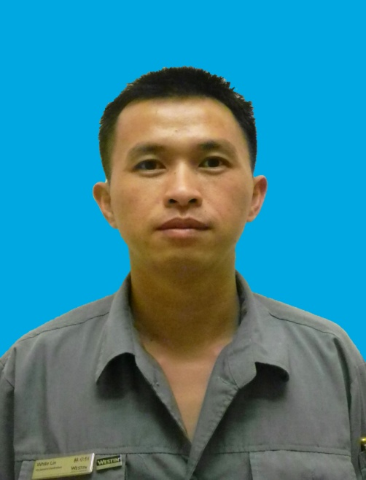
Outstanding Care for Business Award - Third Quarter
第三季度杰出关爱生意奖
White Lin
林卓恒
Engineering
工程部
Shift Leader – ENG
工程主管

Slide 16
Outstanding Care for Business Award - Third Quarter
第三季度杰出关爱生意奖
林卓恒是酒店工程部强电主管，从2012年3月19日加入广交会威斯汀酒店以来，爱岗敬业、工作勤恳且高效。最近不时会接到客人投诉晚上睡到半夜灯会自己亮，检查发现，中间继电器到了一定年限，会产生金属疲劳，造成会不时自动发信号出去，产生半夜亮灯的情况。林卓恒研究了很久，尝试取消中间继电器；在改造的工程中，他还发现我们的插卡取电开关成本比较高，达到每个960元，通过实验和摸索，林卓恒现在可以用取消中间继电器利用原有功能实现取电，将插卡取电开关成本降到10元以下，改造以后，不仅可以降低客人的投诉率，而且能够降低维修成本。目前已改造好6间客房试运行，这几个房间暂时没有接到客人的投诉，他现在准备进行全面改造。
White Lin is the supervisor of Engineering. He is passionate in his job and work efficiently since his start at 19th March 2012.Recently many guests complained that the light will turn on automatically at mid-night. After the checking, he found that the electric relay has reached its limit time which will cause metal fatigue. And it will send out signal automatically. After White Lin’s working in it, he decided to cancel the electric relay. During the period, he found that the switch will cost high to RMB960. After working in it, he discovered that a way to reduce the cost to 10RMB.
White Lin
林卓恒
Engineering
工程部
Shift Leader – ENG
工程主管
Nominated by 提名者：
Mike Shen沈章文, Asst. Chief Engineer副总工程师

Slide 17
Outstanding Care for Business Award - Third Quarter
第三季度杰出关爱生意奖
酒店客房所采用的照明智能控制系统极不稳定，经常出现房间突然没电或灯光不受控的现象。可以想像得到，要是客人突然所住的房间没电并且黑漆漆一片、也没有空调，因故障未排除而不能及时送电，那客人的感受和心情是何等的糟糕，我们酒店的客人体验指数也会随之下降。为了及时排除房间所发生的故障，林主管总是设法向安装单位学习排除问题的办法以及软件参数的设置，通过不懈的努力他已成为一名行家里手。每当客房灯光控制系统出现故障时，他总是及时地解决问题。
Also it decreased the compliant rate and the cost. From now on there were 6 rooms trying to run this system and waiting to deal with the left room. Now the intelligent lighting system is very unstable so that the lights always broke down or be out of control. Imaging that, when the guests came back to his room and found it dark and no air-conditioner was working that he will feel terrible. So it would bring us the low GEI score. Thanks to White’s hard work via learning from the manufacturers and his own experiment, he now becomes a expert to solve almost all the lighting failure on time.
林卓恒还发现客房的请勿打扰灯设计不合理，原来设计师房间里面的请勿打扰灯亮，
White also found the DND light in room’s design was
not suitable.
White Lin
林卓恒
Engineering
工程部
Shift Leader – ENG
工程主管

Slide 18
Outstanding Care for Business Award - Third Quarter
第三季度杰出关爱生意奖
外面却显示不亮，而房间的显示不亮，外面的却显示亮。之后他利用专业知识把房间请勿打扰的灯和房门外显示调整为同步进行，甚至对所有的房间进行一次全面排查和调整，使客人使用起来更加方便。
When guest pressed DND light in room, but there was no DND signal was showed in the outside of the door. Also when there was no DND service in room, but the outside door will show DND light. White found it and changed it with his skill. Also he double checked all the rooms and adjusted it one by one. Now guests are comfortable when using this.
记得有一个犹太人团体入住酒店，由于星斯五是犹太人的节日--安息日，客人需要从入住的23楼沿走火楼梯步行至1楼，要求将所有的楼梯灯从原先的感应控制改为常亮状态，并要保证每一盏灯是亮的。另外同时还有一个接待团要求在5F，16F，31F避难层加装消防走火指示灯牌，每个施工点位都要重新布线走管固定。
One Jewish group came and stayed, due to Friday is their Sabbath, the guests required that they needed walk to the ground floor from 23rd floor, and all the inducting lights should be on all the time. At the same time, another group ask us to add the Fire-escaping
Guidance Sighs on 5th, 16th, 31st floors, with all the
construction point being fixed by rewiring.
White Lin
林卓恒
Engineering
工程部
Shift Leader – ENG
工程主管

Slide 19
Outstanding Care for Business Award - Third Quarter
第三季度杰出关爱生意奖
面对如此迫切的任务和所申购的材料因某些环节迟迟不能到位，他翻箱倒柜通过现有资源、加班加点，再加上销售和采购部同事的大力支持，终于赶在客人要求的时间前圆满完成了任务。
Facing such an urgent task and hard to find the materials, White rummaged through to find some useful makings and finished all the things after working hours. With the support of S&M and Purchasing Dept., he gave our guests a satisfactory answer.
Besides conducting the electrical maintenance, White also takes part in the repairing other professional systems. He is willing to learn and a fast learner. He also finished the outside road’s speech bumps in front of hotel main door. With him, we save a lot of money and energy。
林主管在圆满完成强电维修工作之外，还主动参与工程部各专业系统的维修，发挥他高效而敬业的精神，完成了酒店门外道路减速带等多项维修工作。因为有了他，酒店节约了很多金钱和能源。
Besides conducting the electrical maintenance, White also takes part in the repairing other professional systems. He is willing to learn and a fast learner. With him, we save a lot of money and energy, and we also love to work with him.
White Lin
林卓恒
Engineering
工程部
Shift Leader – ENG
工程主管

Slide 20
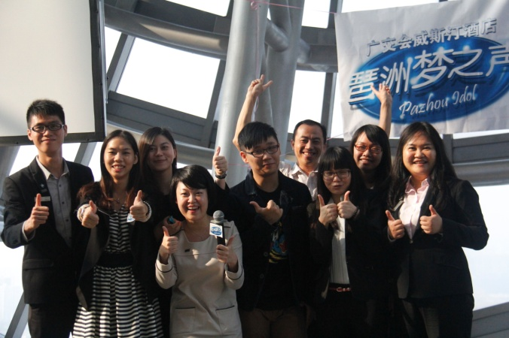
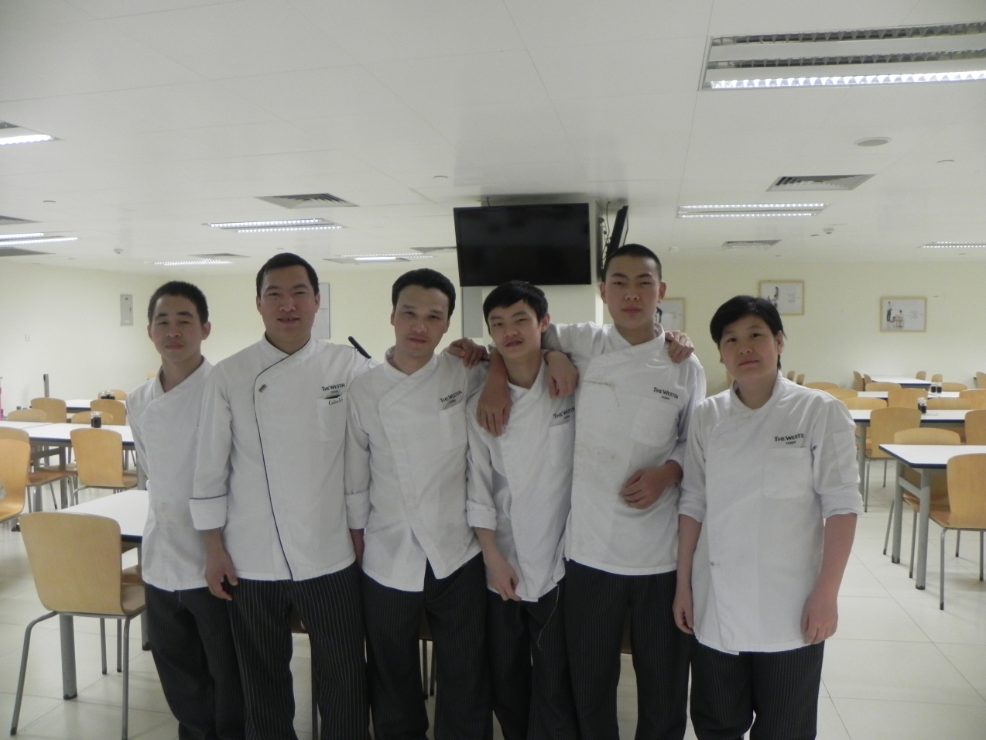
Outstanding Team Award – Third Quarter
第三季度杰出团队奖
HR人力资源部

Slide 21
Outstanding Team Award – Third Quarter
第三季度杰出团队奖
一个杰出的团队不单单在于能获得多少收益，团结、高效、利用最少的资源达到最大的效果才是一个团队应该具有的特质。而人力资源部这个团队正正符合杰出团队的各种特质，在这个季度里，这个杰出的团队通过各种活动和培训向我们充分展现了他们对员工、客人和生意的关爱。
An outstanding team not only can get how much revenue, but also unity, efficient, using the least amount of resources to achieve maximum effect are the characteristics that a team should have. The team of human resources is in line with the outstanding team with various qualities. During this quarter, this outstanding team shows their care of associates guests and business through various activities and training.
这一季度，HR团队关爱员工。他们开展一系列的活动，让员工感受到家庭中的关爱。每一年到第三季度都会有一次出游的活动，如前两年的清远漂流以及大夫山郊游，但今年为了成本的控制，并希望用多种方式丰富员工生活，HR使用最少的成本，利用更多的资源振作大家的士气，
Looking back at this quarter, HR team care associates. They carry out a series of activities to let associates feel the care of the family. They spend the minimum but reach maximum effective. They held 9 activities in this quarter.
HR人力资源部
Nominated by 提名者：
Ivy Lin林丽梅, Asst. Financial Controller助理财务总监

Slide 22
Outstanding Team Award – Third Quarter
第三季度杰出团队奖
在第三季度举办了9个活动（具体活动详情可以看下表），而这9个活动都包含了酒店每位员工的兴趣和大规模地涵盖了酒店每一位同事，参与人数到达1044人。使每位员工都参与到相应的活动中，体现着关爱员工无处不在。
This 9 activities included most of the associates hobbies. There are 1044 people took part in these activities and it shows cares for associates is everywhere.
HR人力资源部
No. | Activities | Date | Face to | Involve Pax.
1 | Pazhou Idol“琶洲梦之声”总决赛 | 2013-8-15and10-10 | All Associates | 150
2 | Talk show“喜达屋关爱‘演说’秀” | 2013-8 to10 | All Associates | 30
3 | Skill Competition-“The Welcome 启动仪式” | 2013-8-16 | All Associates | 80
4 | Swapping Role 角色互换活动 | 2013-8-20 | All Associates | 50
5 | Skill Competition-Cooking 美食新煮意 | 2013-8-29 | All Associates | 40
6 | Double Happiness Lunch 2周年午餐 | 2013-9-2 | All Associates | 200
7 | Basketball Competition“男女混合三人欢乐篮球赛” | 2013-9-9 to10 | All Associates | 80
8 | Starvoice 员工心声调查 | 2013-9-11 to 13 | All Associates | 334
9 | Starwood Careers Graduation and Open Ceremony &Birthday Party of Sep and Oct 喜达屋职业发展计划毕业以及开学仪式 &9-10月份生日会 | 2013-9-17 | Starwood Careers Candidates &Birthday Associates | 80
 | total： | 1044

Slide 23
Outstanding Team Award – Third Quarter
第三季度杰出团队奖
而当结束繁忙的第三季度后,HR团队不是可以放松一下，而是开始另一个巨大的新任务：在秋交会期间担任主要的内部支援力量。我们将深入行政酒廊、商务中心和快捷中心支援，支援时间将达到242小时。而在这种情况下，我们依然还需要维持正常部门的运作。这是不容易的，但是我们相信共同协作对酒店来讲是非常重要的！
After the very busy 3rd Quarter, HR team is not about to relax, but take another new challenge to be the major force in canton fair internal support. We will be in Executive Club/Business Center/Service Express, total support hours is up to 242 hours, however at the same time we still need to ensure the normal operation of HR function. This is not easy, but we believe in Work As A Team is very important to our hotel.
回首这一季度，HR团队关爱客人。他们开展一系列的培训，使得员工的知识水平和服务水平不断的提升。在每个培训中使新员工能在最短的时间里全面认识和了解广交会威斯汀酒店。HR团队把对客人的关爱寄托在培训的内容中，利用精心准备的培训把HR团队的关爱传达给每一个员工。
Looking back at this quarter, HR team care guests. They carried out a series of training and it helps to increase the knowledge level and service quality of the associates. The orientation also makes the new hire know more about the Westin Pazhou and the hotel information.
HR team put their care for the guests in the content of
The training and send it to every associates.
HR人力资源部

Slide 24
Outstanding Team Award – Third Quarter
第三季度杰出团队奖
回首这一季度，HR团队关爱生意。在这么多的活动和培训的情况下，HR员工不仅利用最少的资源达到最大的效果，而且各个活动的支出还相当低。不仅仅是在活动方面，而且HR在这个季度为酒店的生意也是尽心尽力，共销售出198盒月饼，超出原定销售目标98盒。
Looking back at this quarter, HR team care business. In case of so many activities and training HR team not only use the least resources to maximum effect, also the spending of the activities is quite low. It shows their care of business. At the same time HR team do not forget to do floor check. In the daily work they put saving resources in the first place, recycle the paper and checking the items. In selling moon cake part, we sell 198 boxes moon cake.
HR这个杰出的团队团结互爱，他们杰出的表现关爱员工、关爱客人和关爱生意的精神。所以杰出团队他们当之无愧。
This outstanding team unity and love each other. They shows their care of associates, guests and business with action. So they deserved the outstanding team award.
HR人力资源部

Slide 25
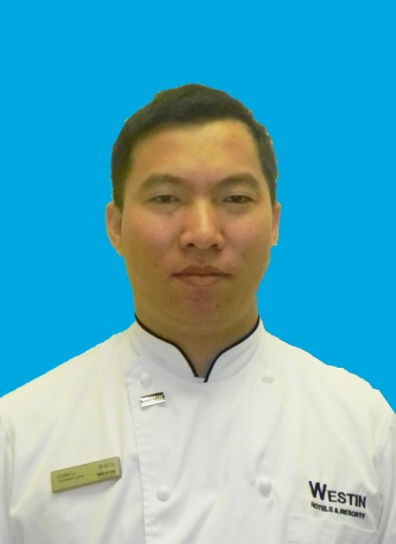
Outstanding Leader Award - Third Quarter
第三季度杰出领导者奖
Colin Li
李保均
F&B
餐饮部
Sous Chef - Associate Dining Kitchen
员工餐厅厨师长

Slide 26
Outstanding Leader Award - Third Quarter
第三季度杰出领导者奖
Colin 是我们酒店员工餐厅的厨师长，他加入喜达屋已有11年，从2011加入广交会威斯汀酒店进行开业筹备至今，他带领员工餐厅全体员工每天为我们准备可口，营养健康的食品。
Colin is our staff canteen chef, he join starwood for 11 years. From 2011 he join the pre opening The Westin Pazhou, to take care of our dining.
从酒店开业至今，在Colin 的带领下员工餐厅的团队一直很稳定，流失率基本为零，直到今年9月份才只有一位员工因为个人原因离职，而在国庆节期间，因为一位员工离职，两位员工有事需要休年假，人手安排不过来，Colin从1号到7号都坐镇在员工餐厅，在2012年的starvoice员工星声调查中，员工餐厅的喜达屋敬业指数为4.8，主管效能指数为4.9，可见员工餐厅的同事对Colin的评价甚高。
From the pre opening, staff canteen team is the most stable team as these is nobody resign, the turnover rate is zero. Until last month, only one staff resign because his personal reason, and during the national holiday except one staff left, two staff need to take annual leave as family issue, there is not enough staff, so Colin work from Oct 1-7. Also we can see the stavoice survey in 2012, staff canteen Starwood Engagement Index is 4.8, Supervisor Effectiveness Index
is 4.9, we can see how they like Colin.
Colin Li
李保均
F&B
餐饮部
Sous Chef - Associate Dining Kitchen
员工餐厅厨师长
Nominated by 提名者：
Peter Su苏为民, Director of F&B餐饮部总监

Slide 27
Outstanding Leader Award - Third Quarter
第三季度杰出领导者奖
员工餐厅每天共有4个用餐时段，早餐，午餐，晚餐和夜宵，每天4个餐段的用餐人数约达900人，比任何一个餐厅每天接待的总人数都要多，因此每天要准备900人次的食物，卫生安全非常重要，而Colin对食材的质量以及烹饪的过程严格把关，因此从开业以来，员工餐厅一直保持零事故，而在保证食品安全及质量的同时，能很好地控制成本，基本上成本都没有超过预算。
Staff canteen offer breakfast, lunch, dinner and supper every day, total cover each day around 900, which cover is more than any restaurant, every day to prepare food for 900 covers, the hygiene is very important, from Pre opening until now, zero accident in the staff canteen, Colin not only can keep good quality of the material ,but also good at control the food cost, most of time control in budget.
我们的同事都是来自五湖四海，而中国本来就有8大菜系，每个地方的饮食习惯不一样，正所谓是众口难调，而Colin通过意见征集，在员工委员会会议中听取领导，员工的建议，不断推陈出新，尽可能满足我们同事的需求，现在周六到周四是家常菜式，周五会变换菜式，
All of our staff come from different place in China, they have different dinning habit, it's very hard for the small staff canteen to achieve all the request , but Colin always collect the suggestions
from our associates and listen to the feedback from
the associate committee,
Colin Li
李保均
F&B
餐饮部
Sous Chef - Associate Dining Kitchen
员工餐厅厨师长

Slide 28
Outstanding Leader Award - Third Quarter
第三季度杰出领导者奖
吃面条，饺子，还有各式的配菜，搭配时令水果，早餐也是丰富有营养的，有酸奶，粥，或者是豆浆油条，有馒头，面包，面条，北方和南方菜式结合，有时候同一个菜式会做两种味道，一款辣一款不辣，照顾到不同口味的同事，他总是很认真的倾听同事意见，让大家虽然身在远方工作，依然可以尝到家的味道。
now we have kinds of food, from Saturday to Thursday we have the home made dishes, Friday we can taste dumpling, noodles, in the breakfast, we have soymilk, youghurt , which is full of nutrition. Sometime same dish will be cook in two style, south and north style, spicy and not spicy, Colin always try his best to achieve associate requires.
员工餐厅除了要为酒店同事以及业主供应4个餐段以外，有时候做外卖或者大型宴会需要为帮工和我们的员工准备饭盒，无论数量多或少，Colin都能合理地安排人手，按时准备既定的饭盒数量， 有时候有大型外卖的时候也会安排人手去帮助西厨和中厨房。
Except to arrange the staff canteen, when banquet have the big event or outside catering, they need to prepare the lunch or dinner box for the outsource, some they will help western kitchen and
Chinese kitchen to do the outside catering. Colin always
can arrange the man power.
Colin Li
李保均
F&B
餐饮部
Sous Chef - Associate Dining Kitchen
员工餐厅厨师长

Slide 29
Outstanding Leader Award - Third Quarter
第三季度杰出领导者奖
还记得上一年的火锅大餐吗？还记得9月份酒店2周年庆典的自助餐吗？还有每月一次的superfood 主题？Colin和他的团队总能把为我们准备最健康营养丰富的饭菜，他们总能把事情做的井井有条。谢谢Colin和他的团队，谢谢我们的米饭班主，一直照顾着我们的饮食，为我们的工作给予的极大的物质支持。
Do you remember last year hot pot lunch? The 2 year anniversary buffet lunch this year? And once per month superfood lunch? Thanks to Colin and his team to offer so delicious food for us
Colin Li
李保均
F&B
餐饮部
Sous Chef - Associate Dining Kitchen
员工餐厅厨师长

